Slide 1
INMOST – a software platform for distributed mathematical modelling
Kirill Terekhov, Alexander Danilov, Ivan Kapyrin, Igor Konshin, Kirill Nikitin, Yuri Vassilevski
ECCM-ECFD18

Slide 2
INMOST
functionality

Slide 3
What is INMOST?
INMOST abbreviation for (courtesy of Yuri):
Integrated
Numerical
Modelling and
Object-oriented
Supercomputing
Technologies
Conceived during my internship at University of Houston / Exxon-Mobil in 2012.
Notes:
Current talk is focused on

Slide 4
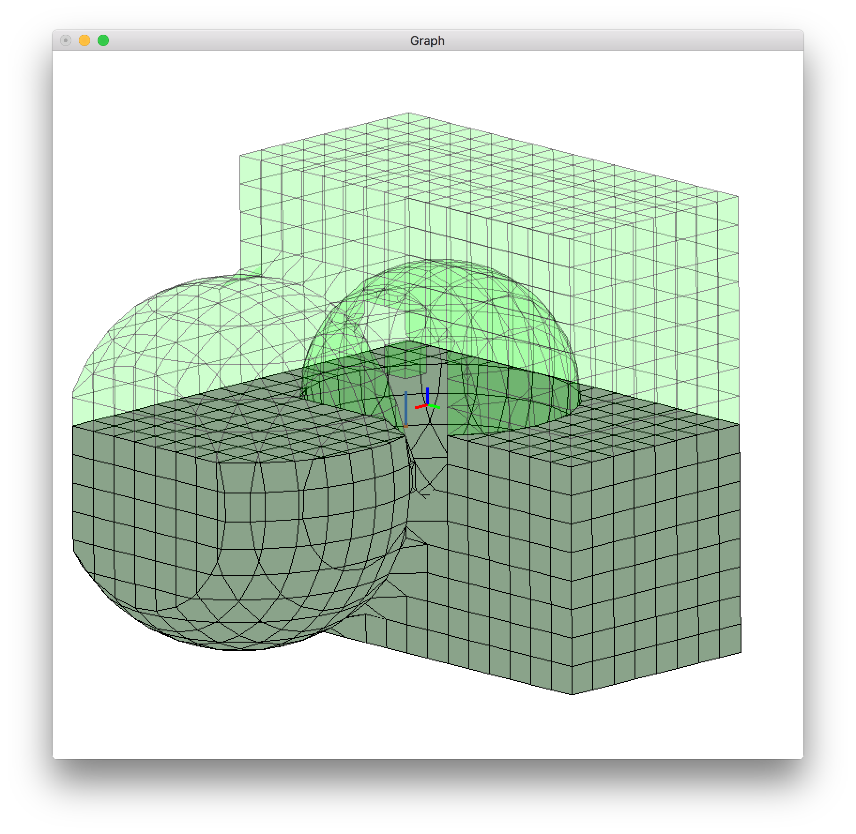
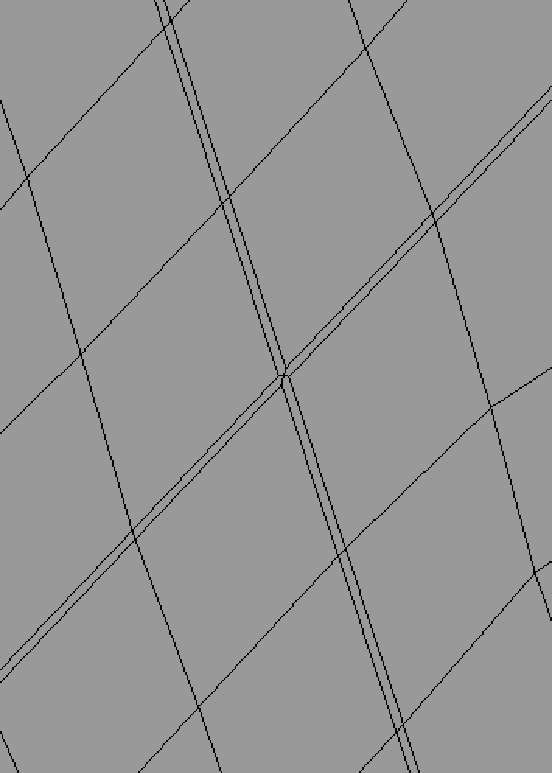
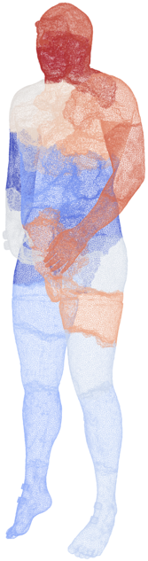
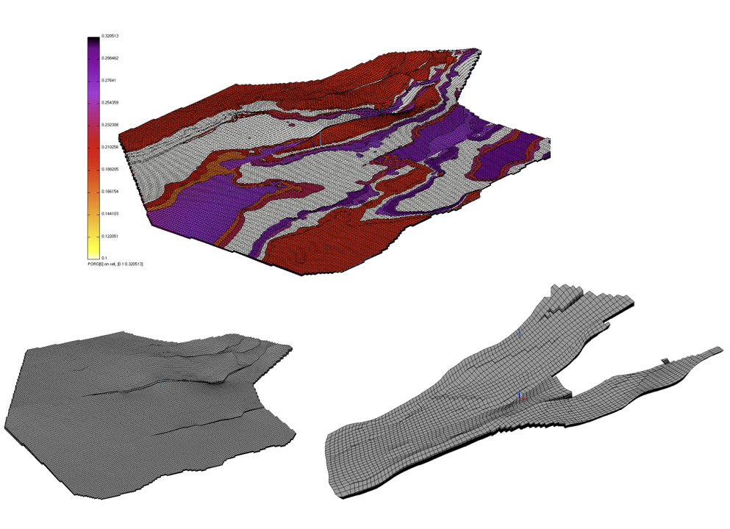
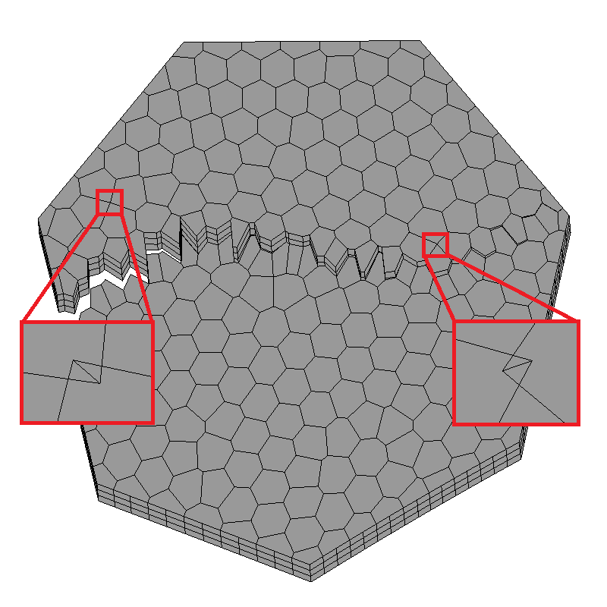
INMOST: Grids
Complex modifications
Cracking the mesh
Model
Of human body
Geological grids with pinch-outs,
Supports Eclipse simulator format
Grid restoration

Slide 5
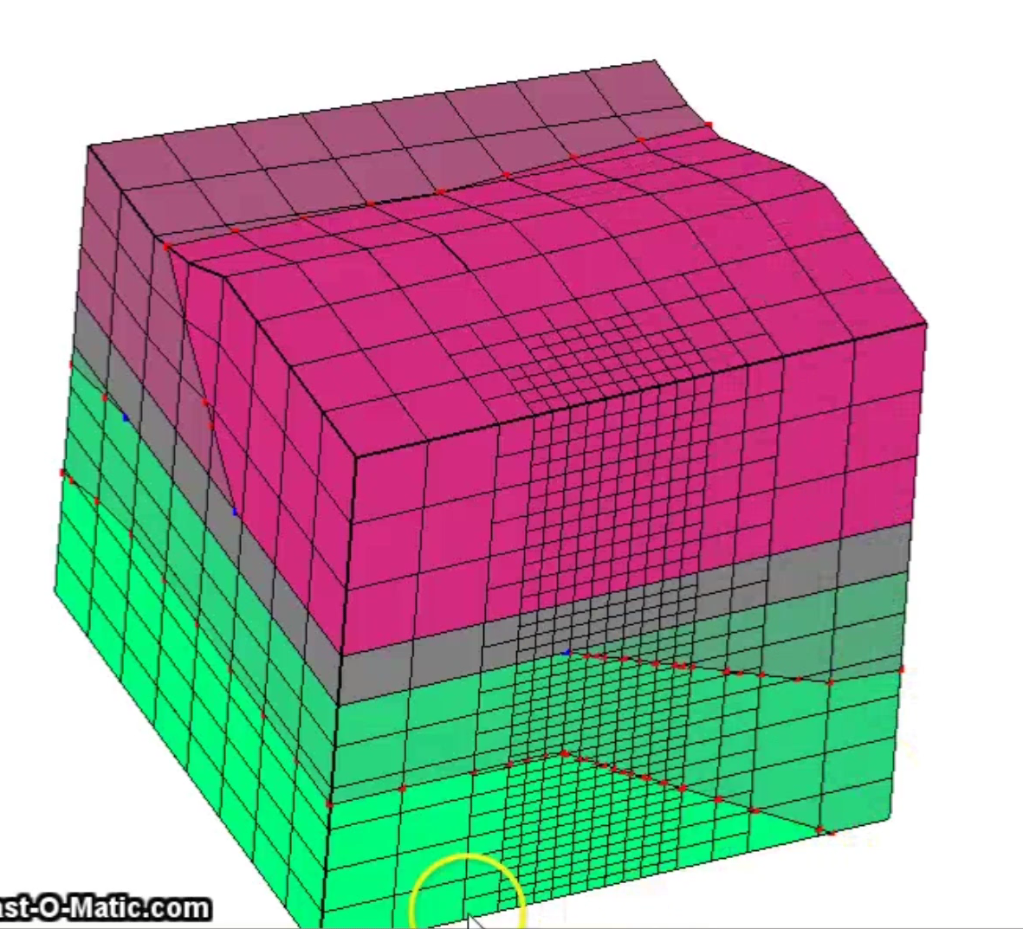
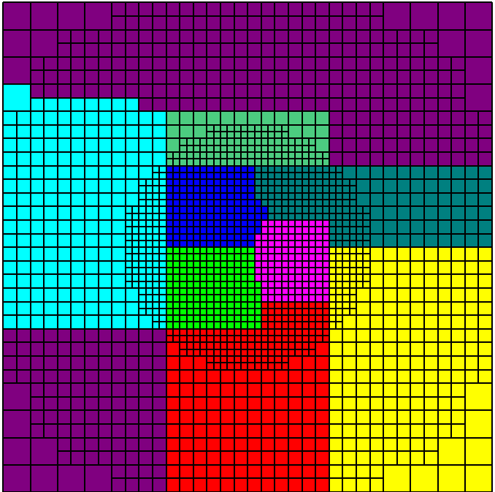
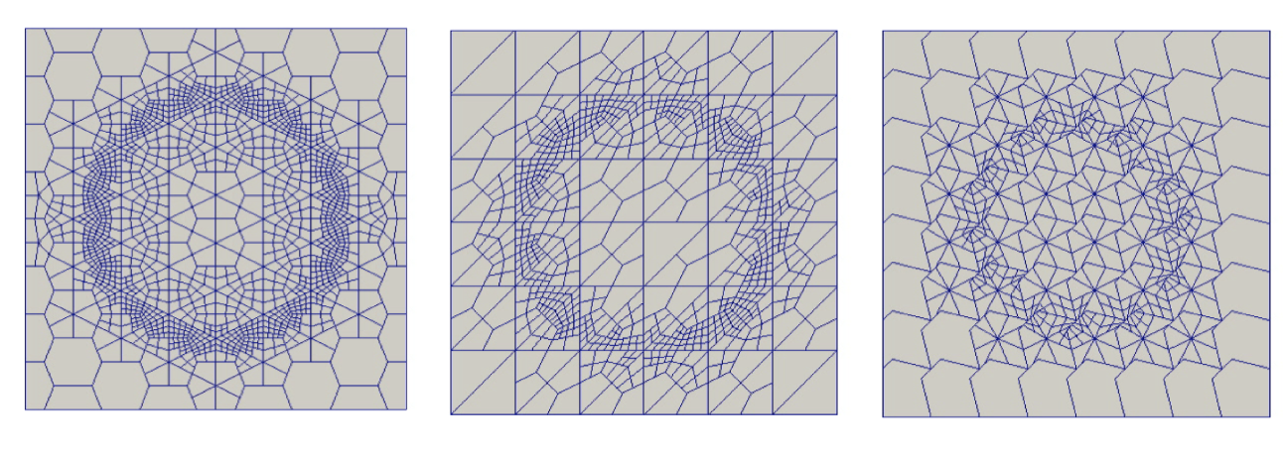
INMOST: Dynamic grids
Parallel scalable dynamic mesh
Adaptation and balancing
Built-in OctreeCutcell example
AdaptiveMesh example for general grid adaptation.

Slide 6
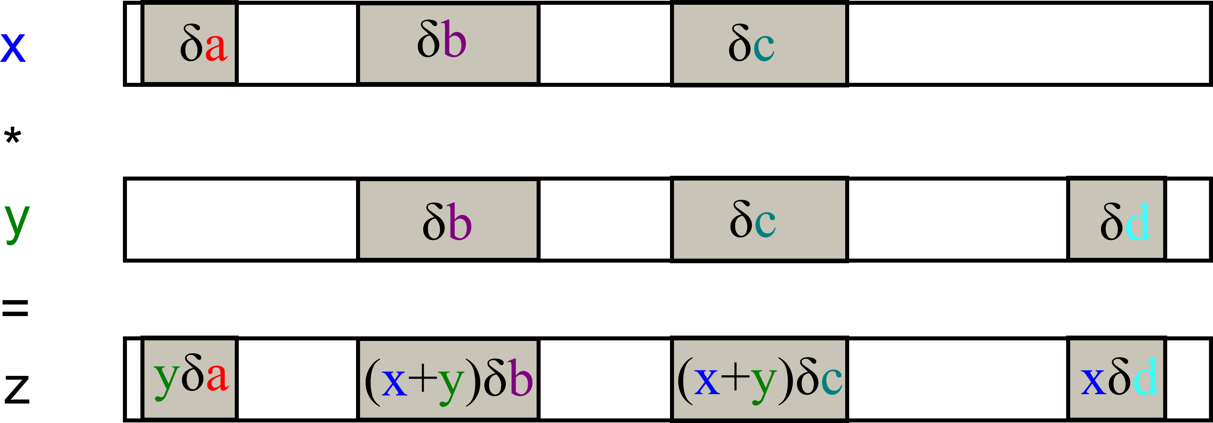
INMOST: Auto-differentiation
Computes Jacobian matrix.
Very useful for complex nonlinear problems.
INMOST provides BLAS-like linear algebra functionality with automatic differentiation.
Most modelling examples further use this functionality.
Notes:
Oftenly when one works with physics applications one has to consider variations. Variations are need for example to obtain Jacobian and solve a nonlinear problem with Newton method. Usually it’s very time-consuming to follow transformations for variations in complex nonlinear expressions. Automatic differentiation is a known technique to address this issue. Say variable x depends on unknowns a,b,c and variable y on b,c,d then the variation of multiplying x and y is obtained automatically.

Slide 7
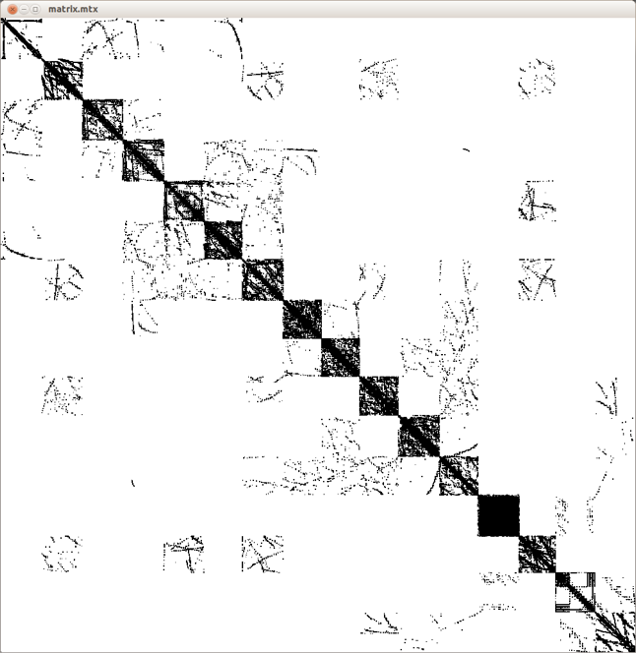
INMOST: Solvers
Easy structures for assembly of distributed linear systems in parallel.
Distributed solve:
Call to PETSc, Trilinos, SuperLU, Hypre.
Methods by Kaporin and Konshin.
My own developements.
Also: mesh balancing and migration, any number of ghost layers, grid data exchange.

Slide 8
INMOST: Multiphysics
Decouple simulator by models.
Models are coupled by functions:
mobility, density, porosity, etc.
Or by coupling terms:
Biot term, incompressibility, capillarity, etc.
INMOST can manage:
Models, unknowns, functions, couplings, assembly of residual and Jacobian.
Fully implicit solution.
Equations
Unknowns
u,v,w
p
S_{o,} S_{w,} S_{g}
T
Deformation
Elasticity
Biot
term
Capillary
effects
Thermal
expansion
Biot term,
rock porosity
Flow
Capillary
effects
Thermal
effects
Darcy
Structure
movement
Flow
velocity,
mobility
Fluids
Heat
gradient
Advection
Structure
movement
Flow
velocity
Density
gradient
Thermal
Conduction
Models and some couplings in reservoir simulator

Slide 9
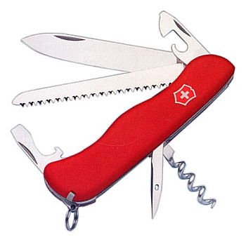
INMOST: Users and development
Users:
INM RAS;
IBRAE RAS, Rosatom – Ivan Kapyrin’s lab, GeRa code;
Stanford, USA – group of Hamdi Tchelepi, AD-GPRS code;
Hariot-Watt, UK – Christina Mayer;
KHU, Qatar – Ahmad Abushaikha;
TU Delft, Holland – Denis Voskov.
Occasionally:
Total, Chevron, Exxon-Mobil, Storengy, INPEX, Samsung, maybe Siemens.
Further developments:
Multiphysics.
Linear solvers.
Detailed documentations.
FV-book with Springer.

Slide 10
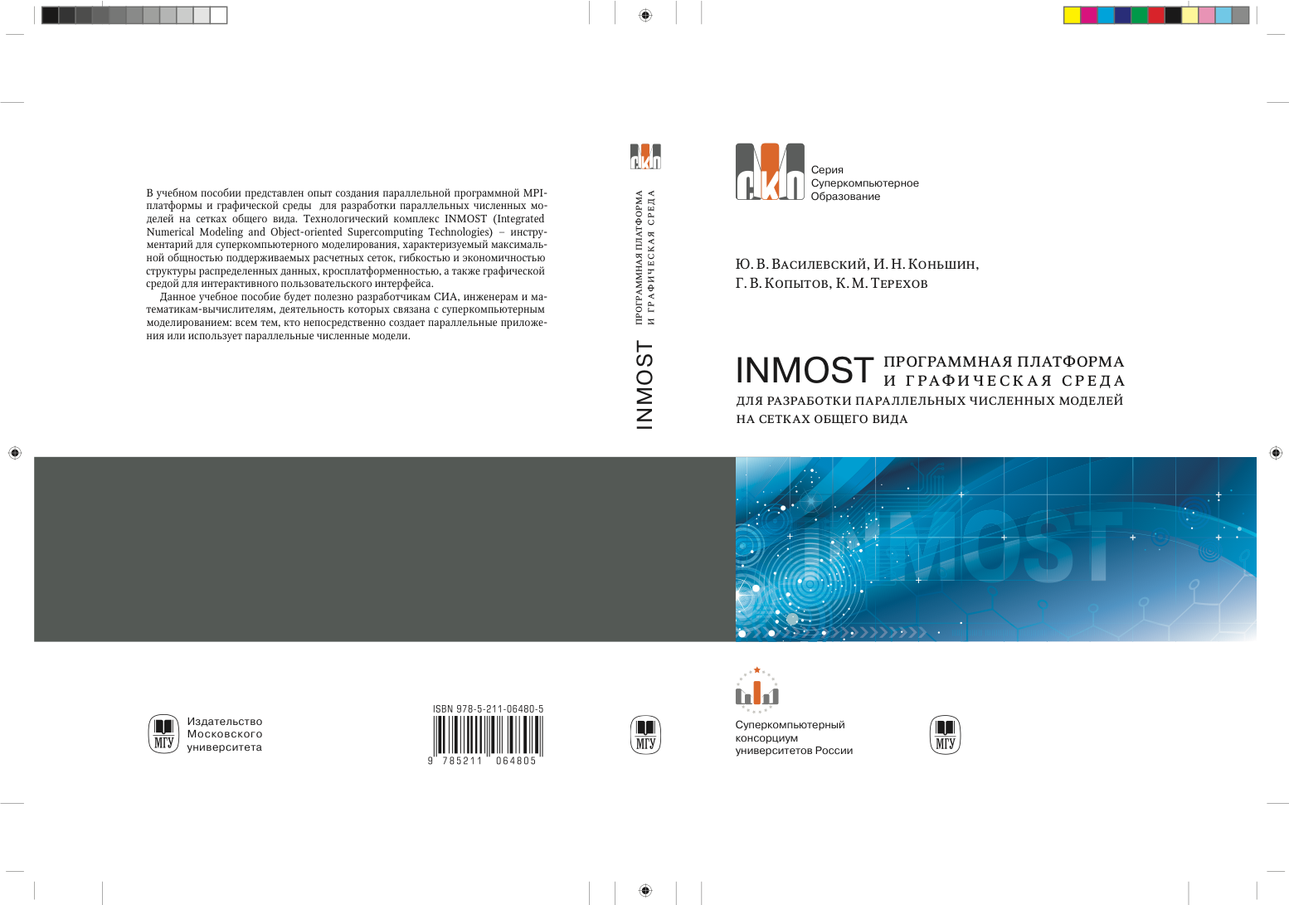

Slide 11


Slide 12
INMOST: Today
Supported open-source BSD-licensed project
Exists on git on http://github.com/INMOST-DEV/INMOST
Short address http://www.inmost.org
Doxygen documentation: http://doxy.inmost.org
Wiki documentation: http://wiki.inmost.org
Many integrated examples and instruments.

Slide 13
Models
on INMOST

Slide 14
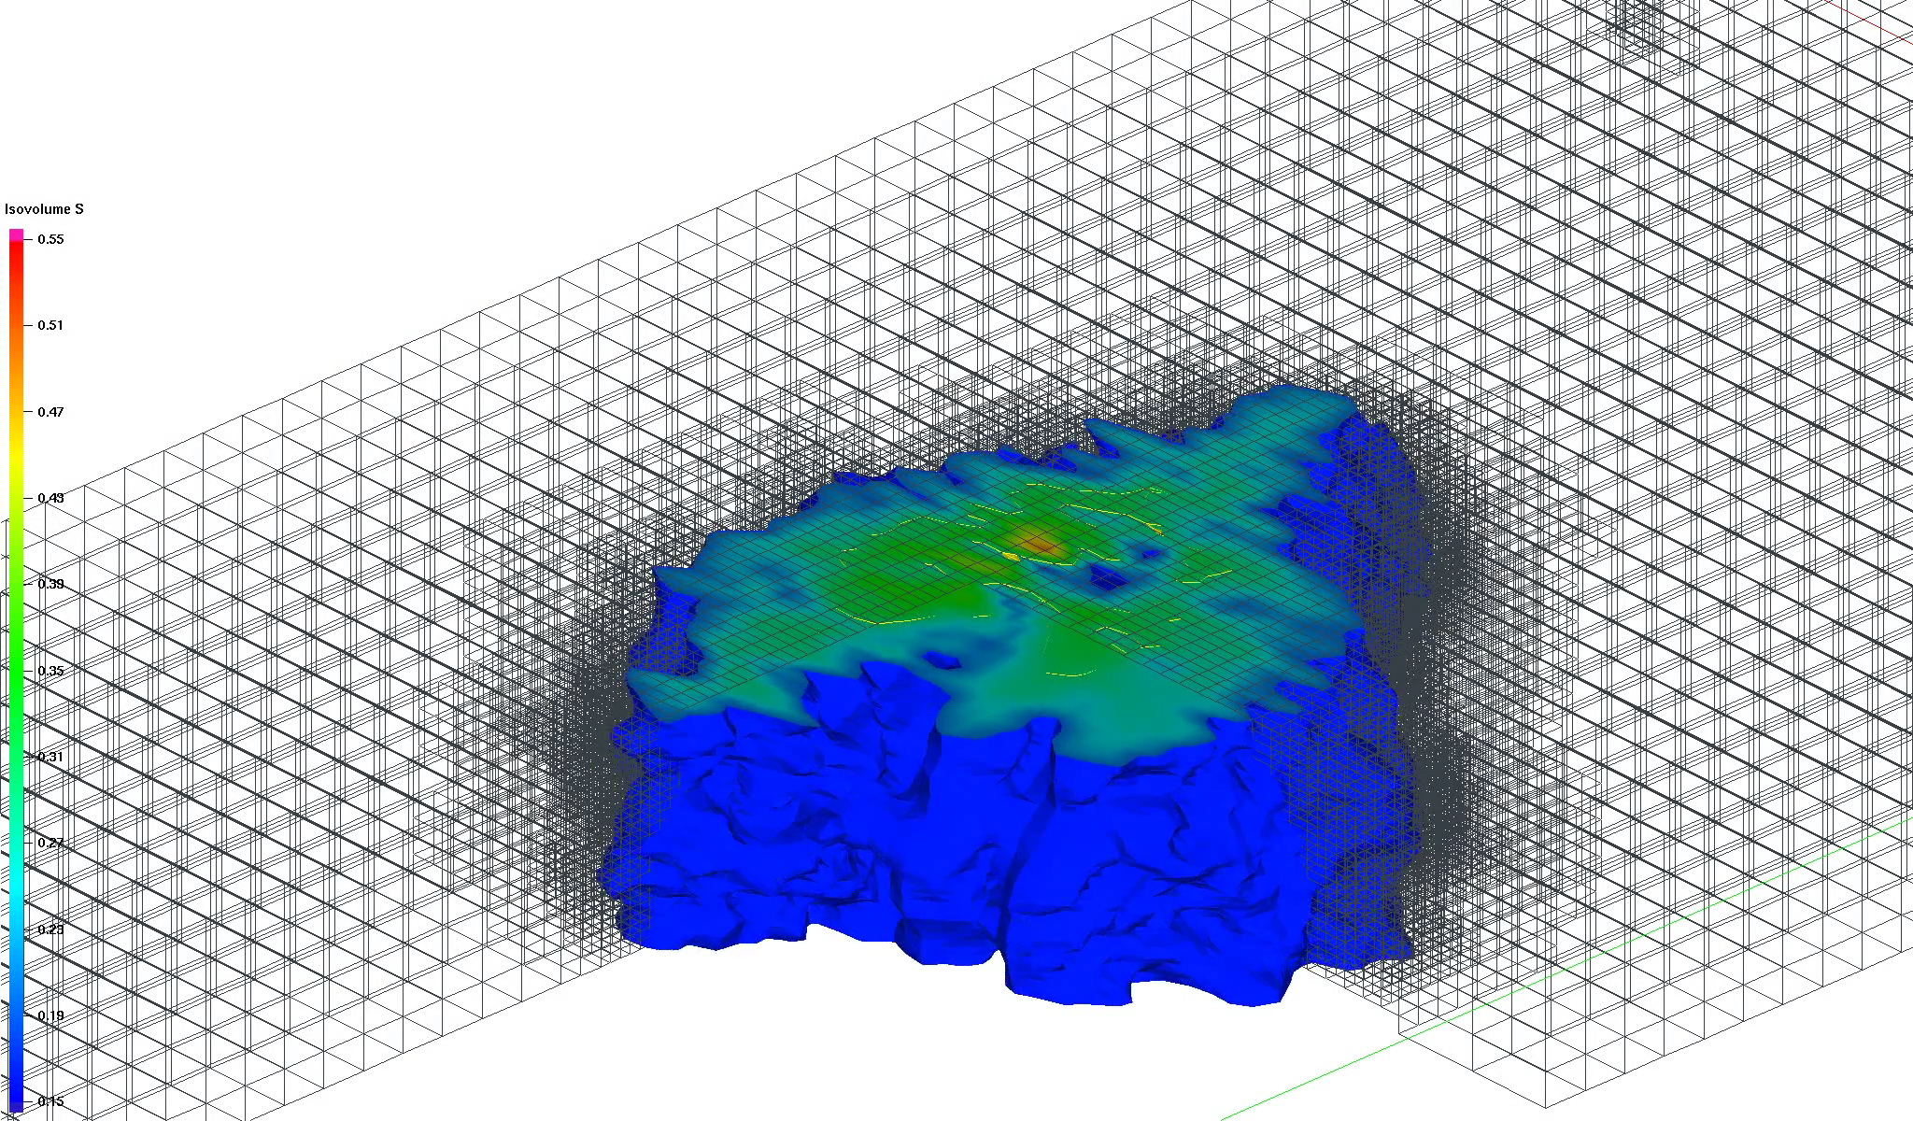
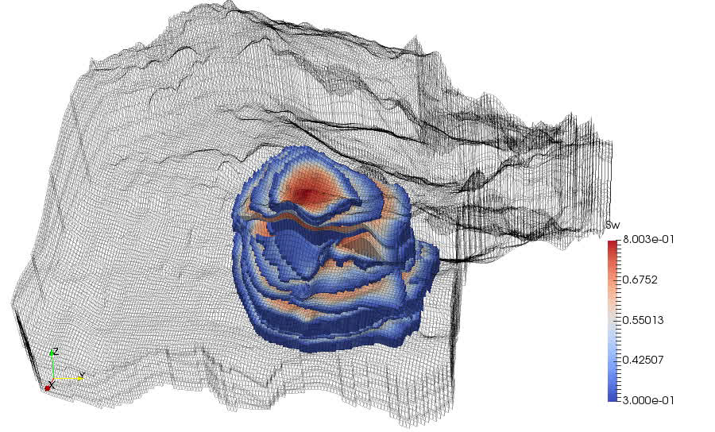
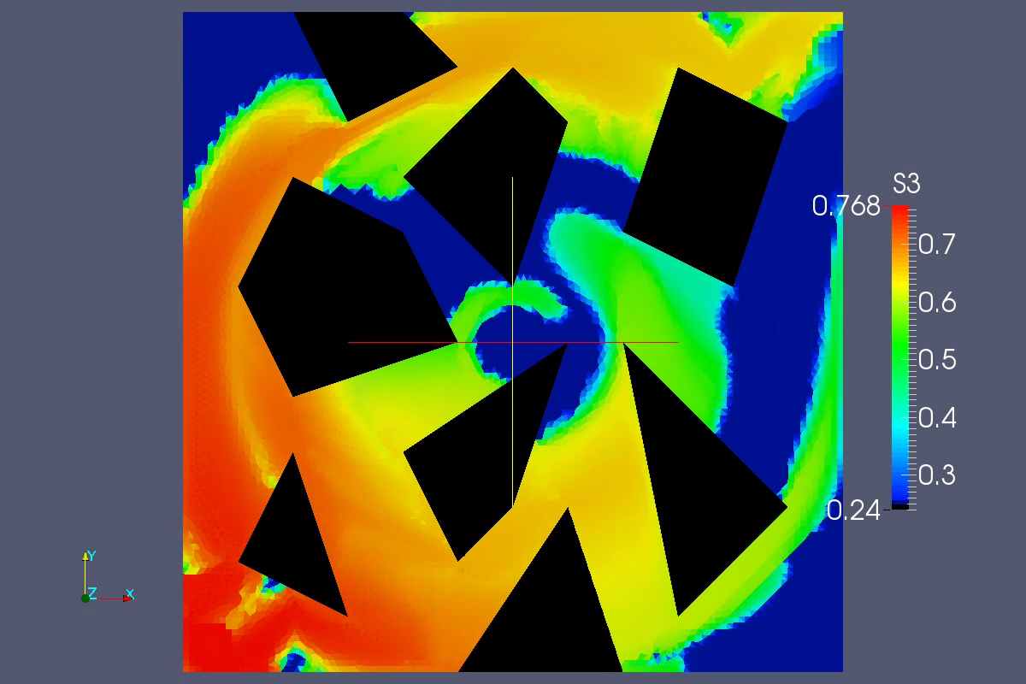
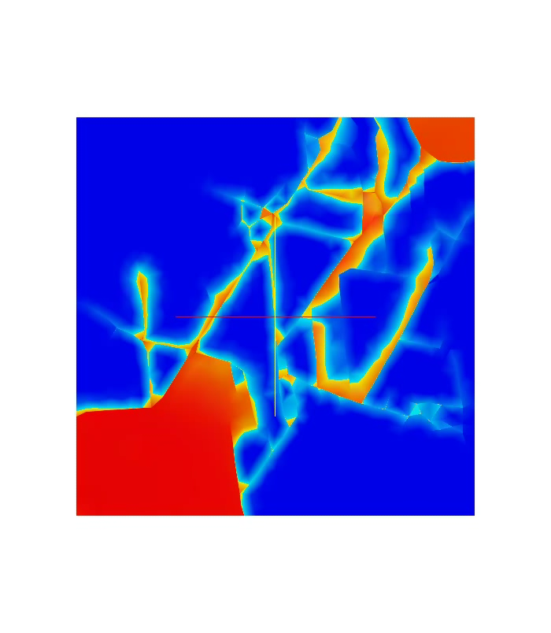
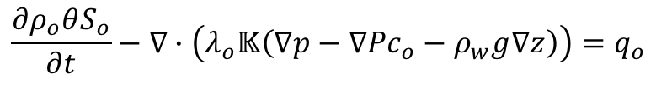
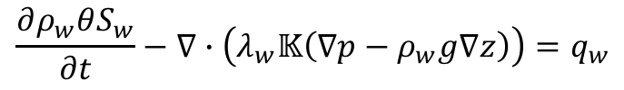
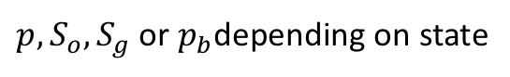
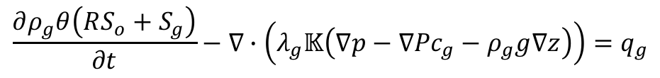
Models: Black-oil
Unknowns:
$p, S_{o},S_{g}$ or $p_{b}$depending on state
Equations:
$$\frac{∂ρ_{w}θS_{w}}{∂t}−∇∙\left(λ_{w}𝕂\left(∇p−ρ_{w}g∇z\right)\right)=q_{w}$$
$$\frac{∂ρ_{o}θS_{o}}{∂t}−∇∙\left(λ_{o}𝕂\left(∇p−∇{Pc}_{o}−ρ_{w}g∇z\right)\right)=q_{o}$$
$$\frac{∂ρ_{g}θ\left(RS_{o}+S_{g}\right)}{∂t}−∇∙\left(λ_{g}𝕂\left(∇p−∇{Pc}_{g}−ρ_{g}g∇z\right)\right)=q_{g}$$
Dynamic grids, SPE10 based geology
Complex realistic geometry
Extreme anisotropy
Fractures
Notes:
Left and top pictures – own simulator, other two – AD-GPRS

Slide 15
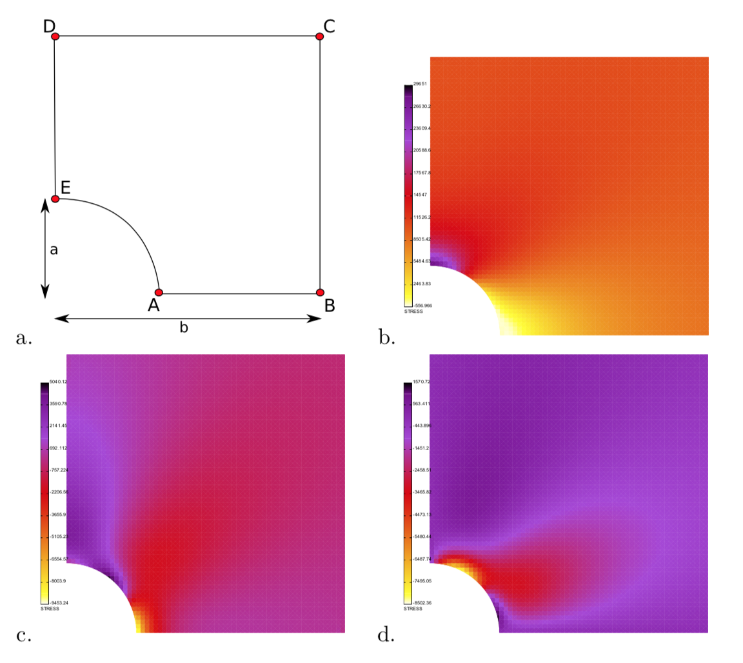
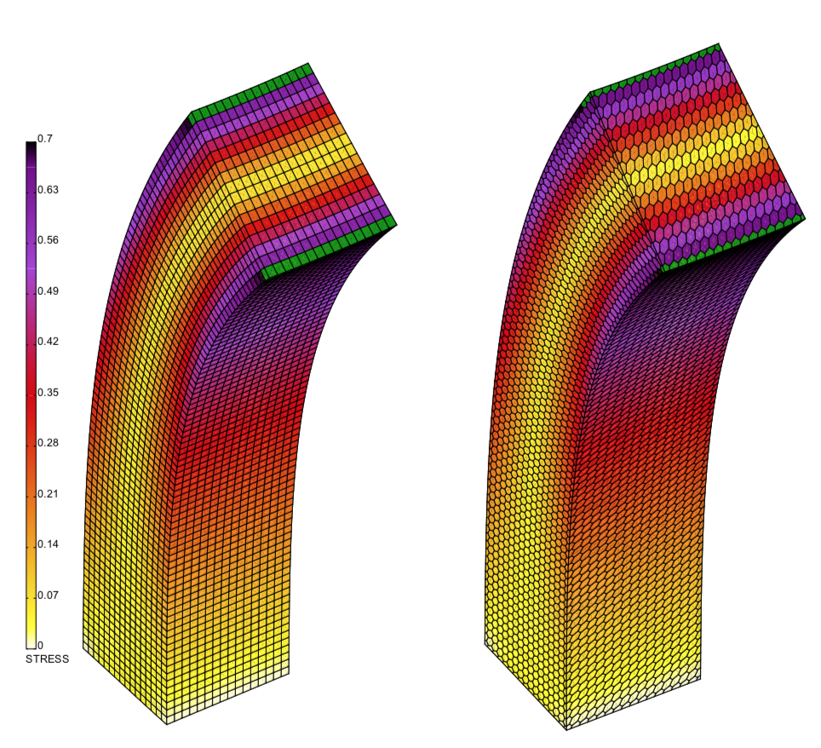
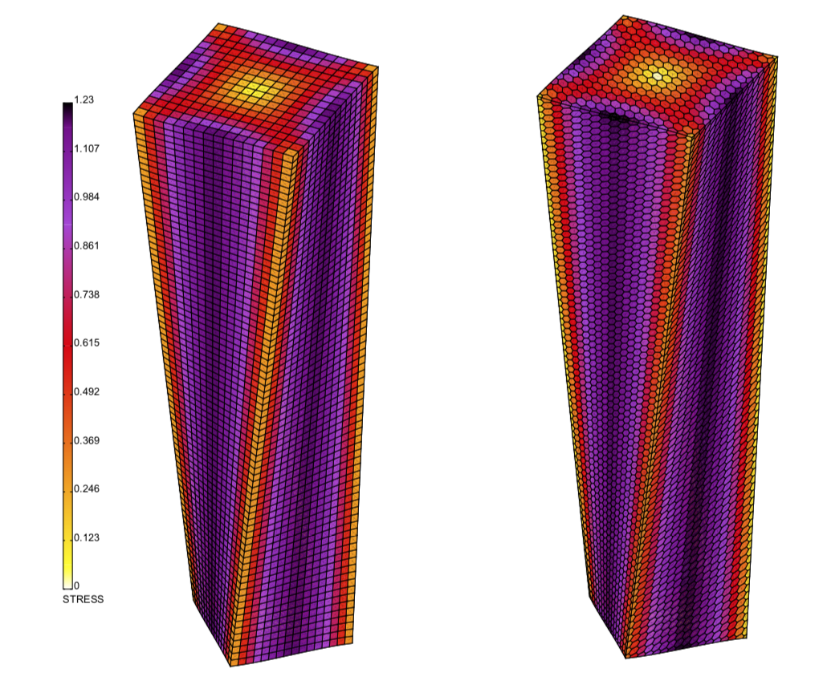
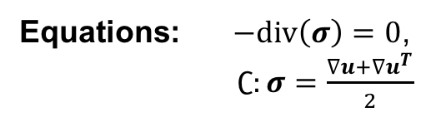
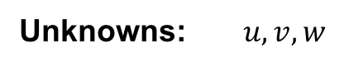
Models: Linear elasticity
Unknowns: $u,v,w$
Equations: $−div\left(σ\right)=0$,
$∁:σ=\frac{∇u+∇u^{T}}{2}$
Loading
Twist
Bend

Slide 16
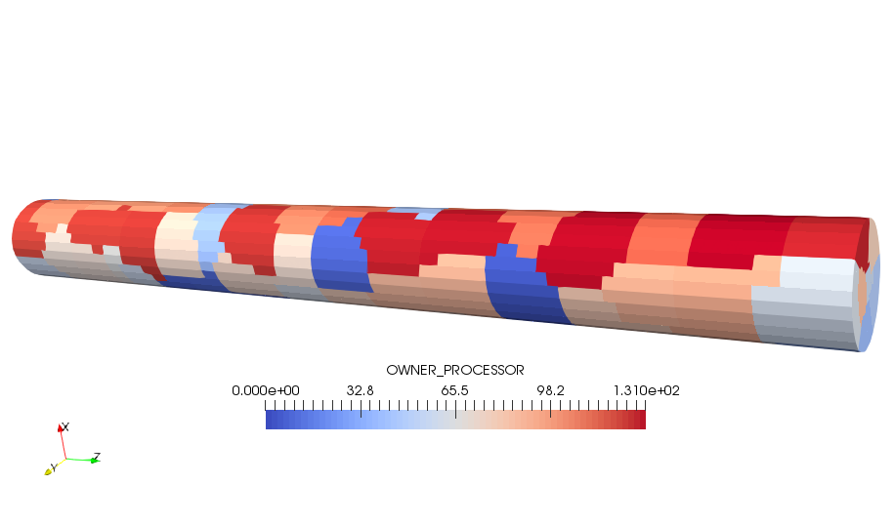
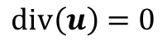
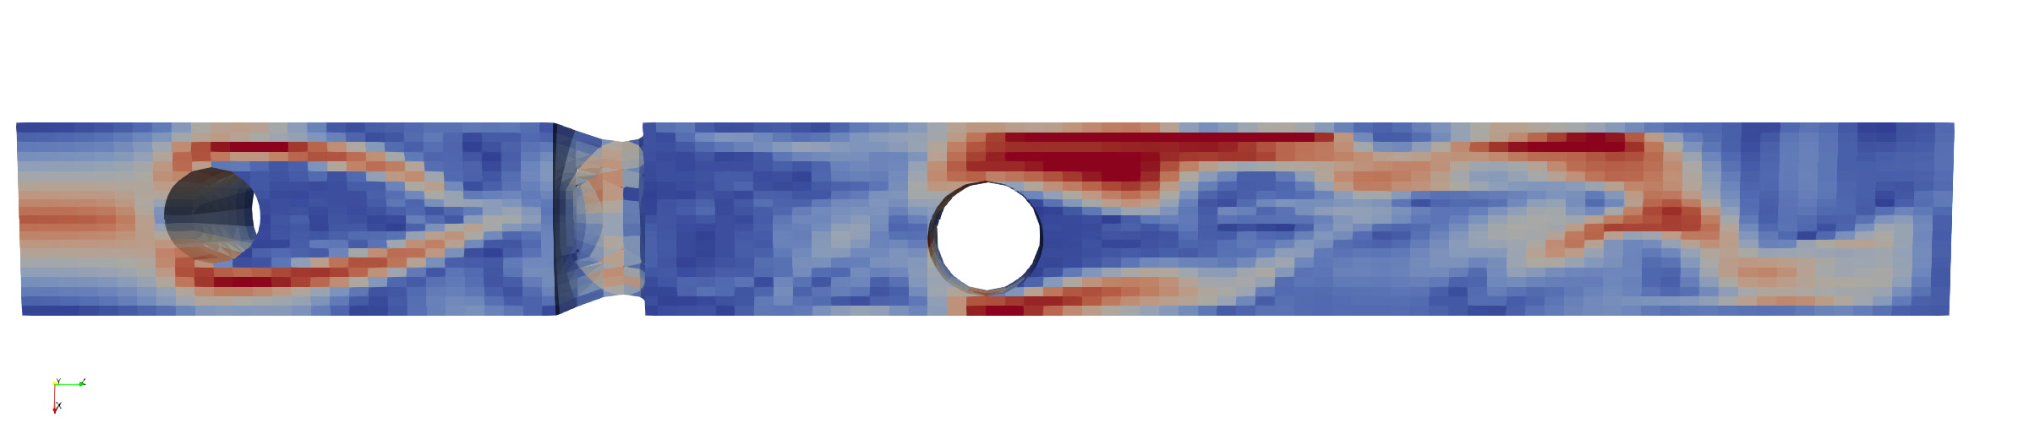
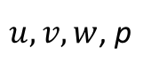
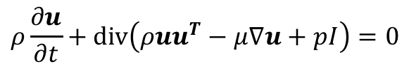
Models: Incompressible fluid
Unknowns:
$u,v,w$, p
Equations:
$$ρ\frac{∂u}{∂t}+div\left(ρuu^{T}−μ∇u+pI\right)=0$$
Parallel, one newton iteration:
36 procs: 2.51 sec
92 procs: 1.25 sec

Slide 17
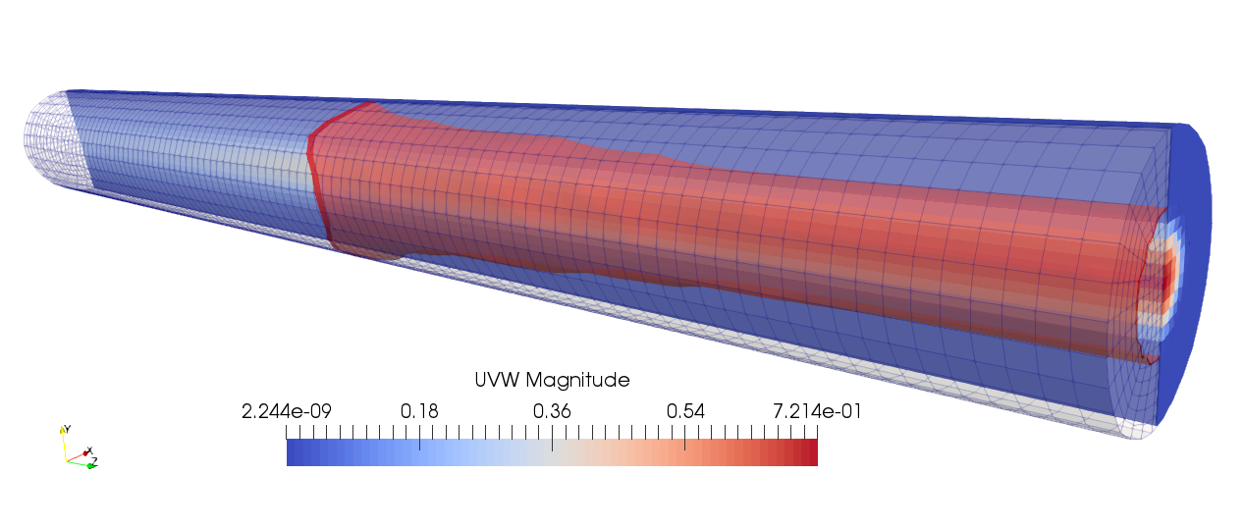
Models: Blood coagulation
Unknowns: $u,v,w,p,PT,T, A, Ba, F, Fp, Fg, φ_{f},φ_{c}$
Equations: Incompressible N-S + Darcy, nonlinear advection-diffusion + reactions
Using ~80 processors to
simulate on fine mesh

Slide 18
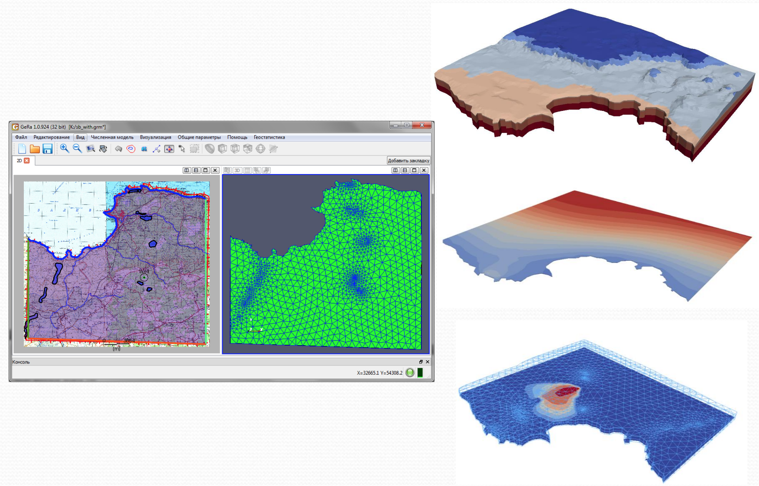
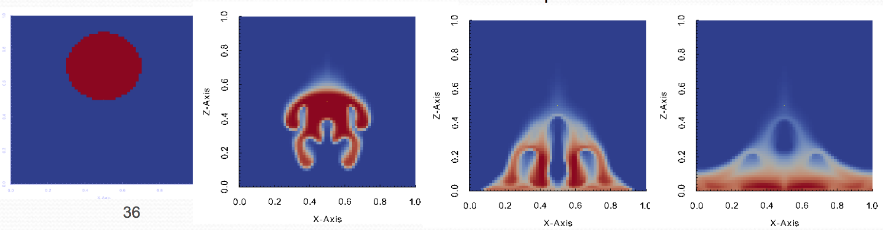
Models: Nuclear Waste Disposal (GeRa)
Mature end-user application with interface. Uses INMOST for mesh generation and parallel mesh management, solution of linear systems.
Physics:
multiphase filtration;
density convection;
sorption;
chemistry;
…
Program interface
Simulation result
Density convection

Slide 19
Finite-volume methods
for Multi-physics

Slide 20
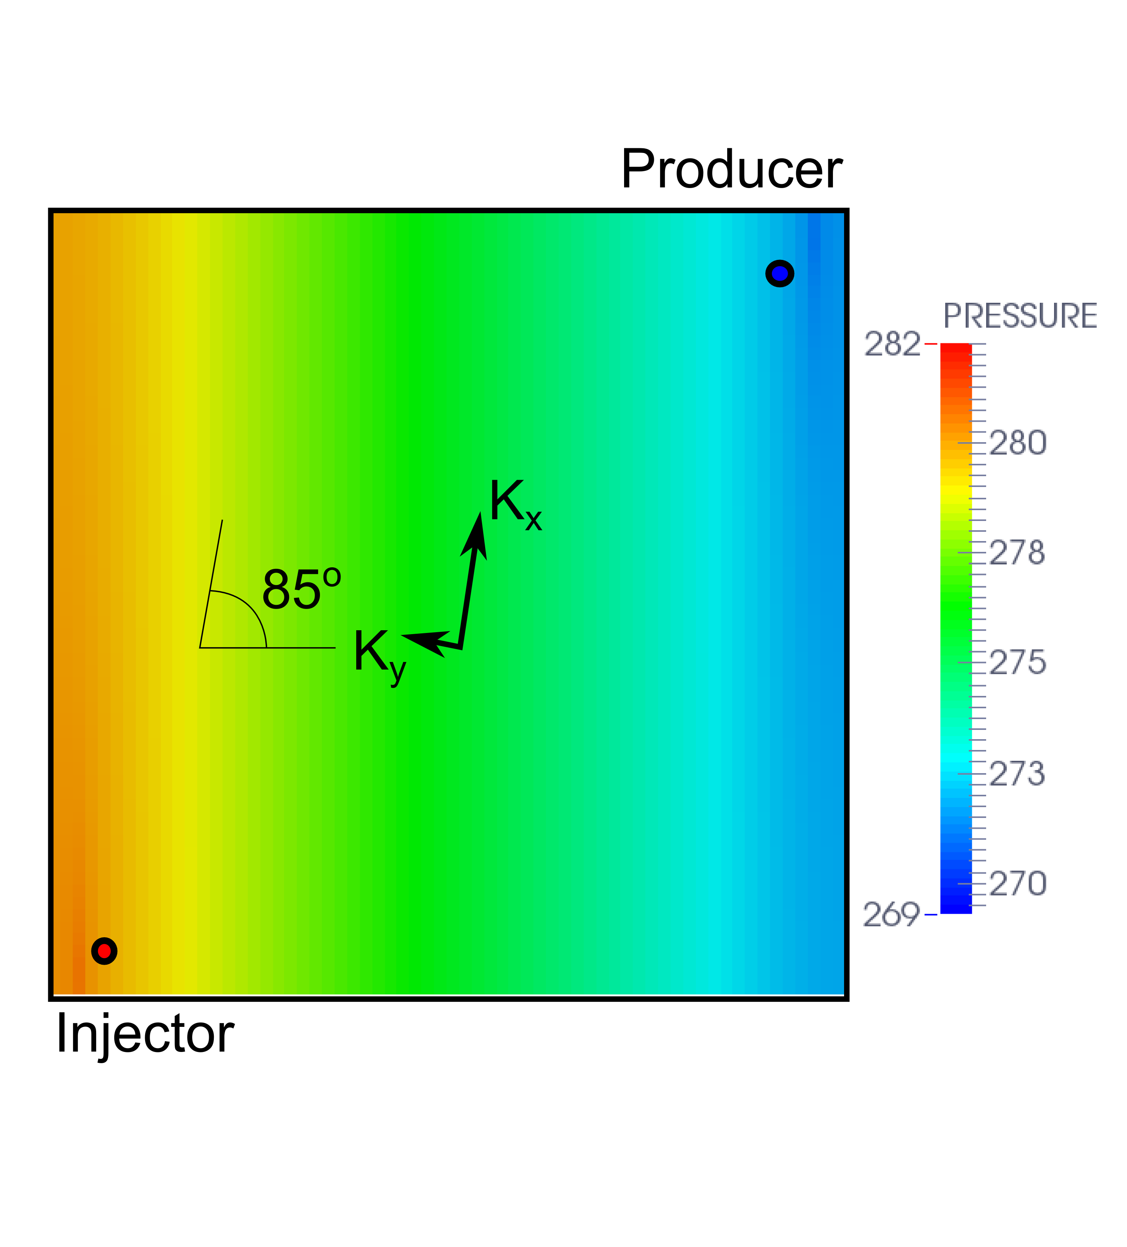
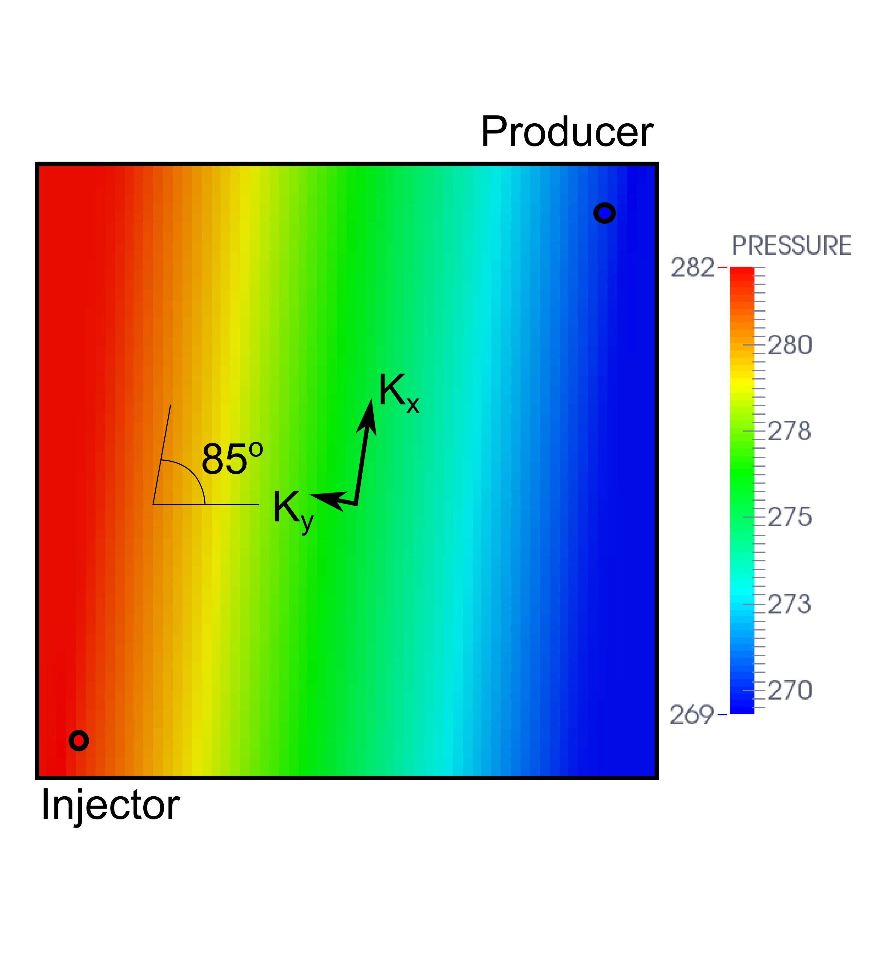
Simple single phase diffusion problem
TPFA, O(1)-error, incorrect
MPFA-O, O(h²)-error, accurate
Notes:
The Darcy law lays in the core of the typical reservoir simulator. To demonstrate the issues, we consider the darcy law with unit mobility that results in anisotropic diffusion problem. The problem considered is the problem with small permeability ratio and the tensor is slightly rotated, on the lower left corner there is an injection well on the upper right corner – a producer well. The grid is Cartesian, which is not K-orthogonal for this case. On the left we see the highly incorrect result with the two-point flux approximation method and on the right the accurate result with the second order accurate result obtained with MPFA-O method. The results is horrifying and while we may expect large inaccuracies from estimation of permeability, the numerics are supposed to be correct.

Slide 21
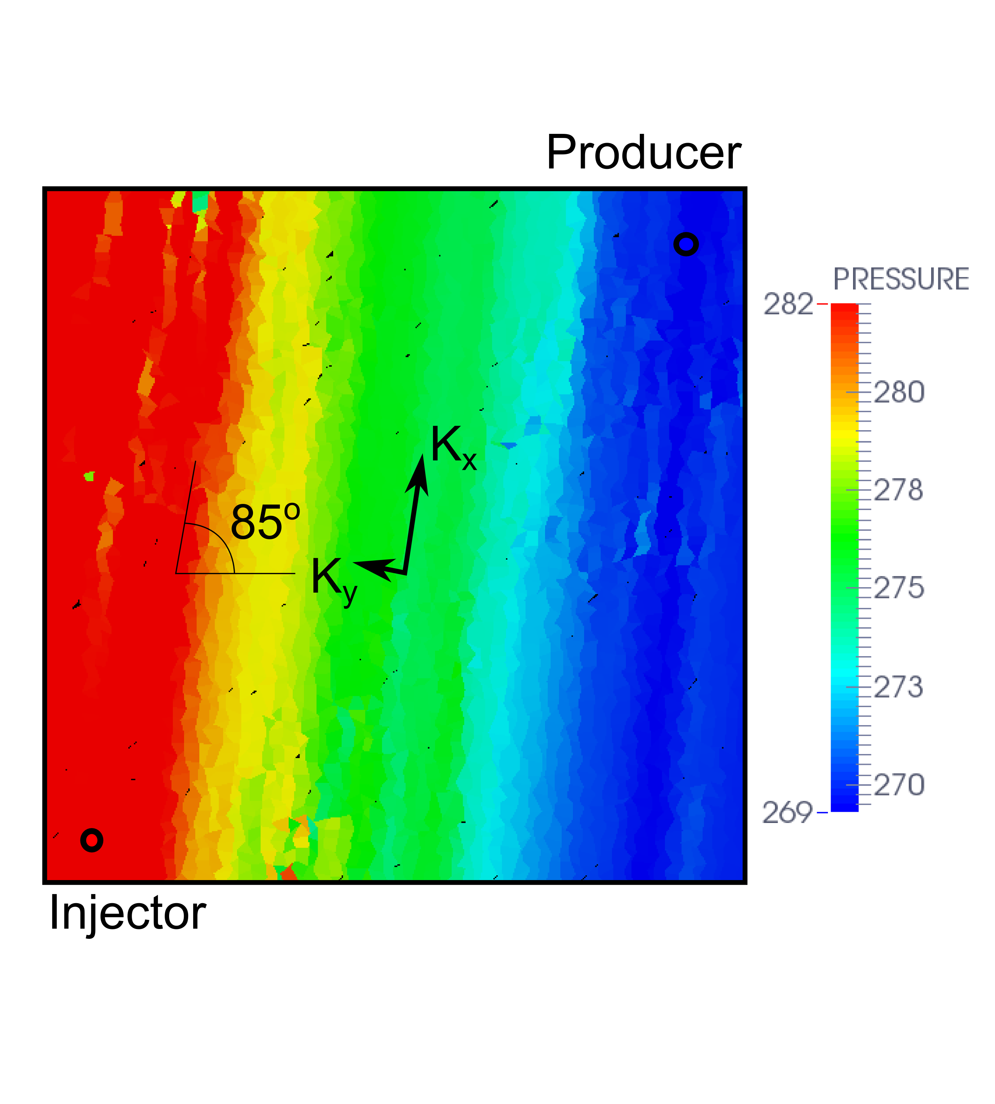
Simple single phase diffusion problem
Issues
MPFA-O
Issues
MPFA-O, Cartesian grid, accurate
MPFA-O, skewed Cartesian grid, unstable
Notes:
Although the MPFA-O scheme very well reproduces the solution on regular Cartesian grid, the result on randomly skewed grid is not as good and demonstrates unphysical violation of the discrete maximum principle. Such a behavior may have a huge negative effect on resulting rates of oil recovery. This fact welcomes a more robust alternative.

Slide 22
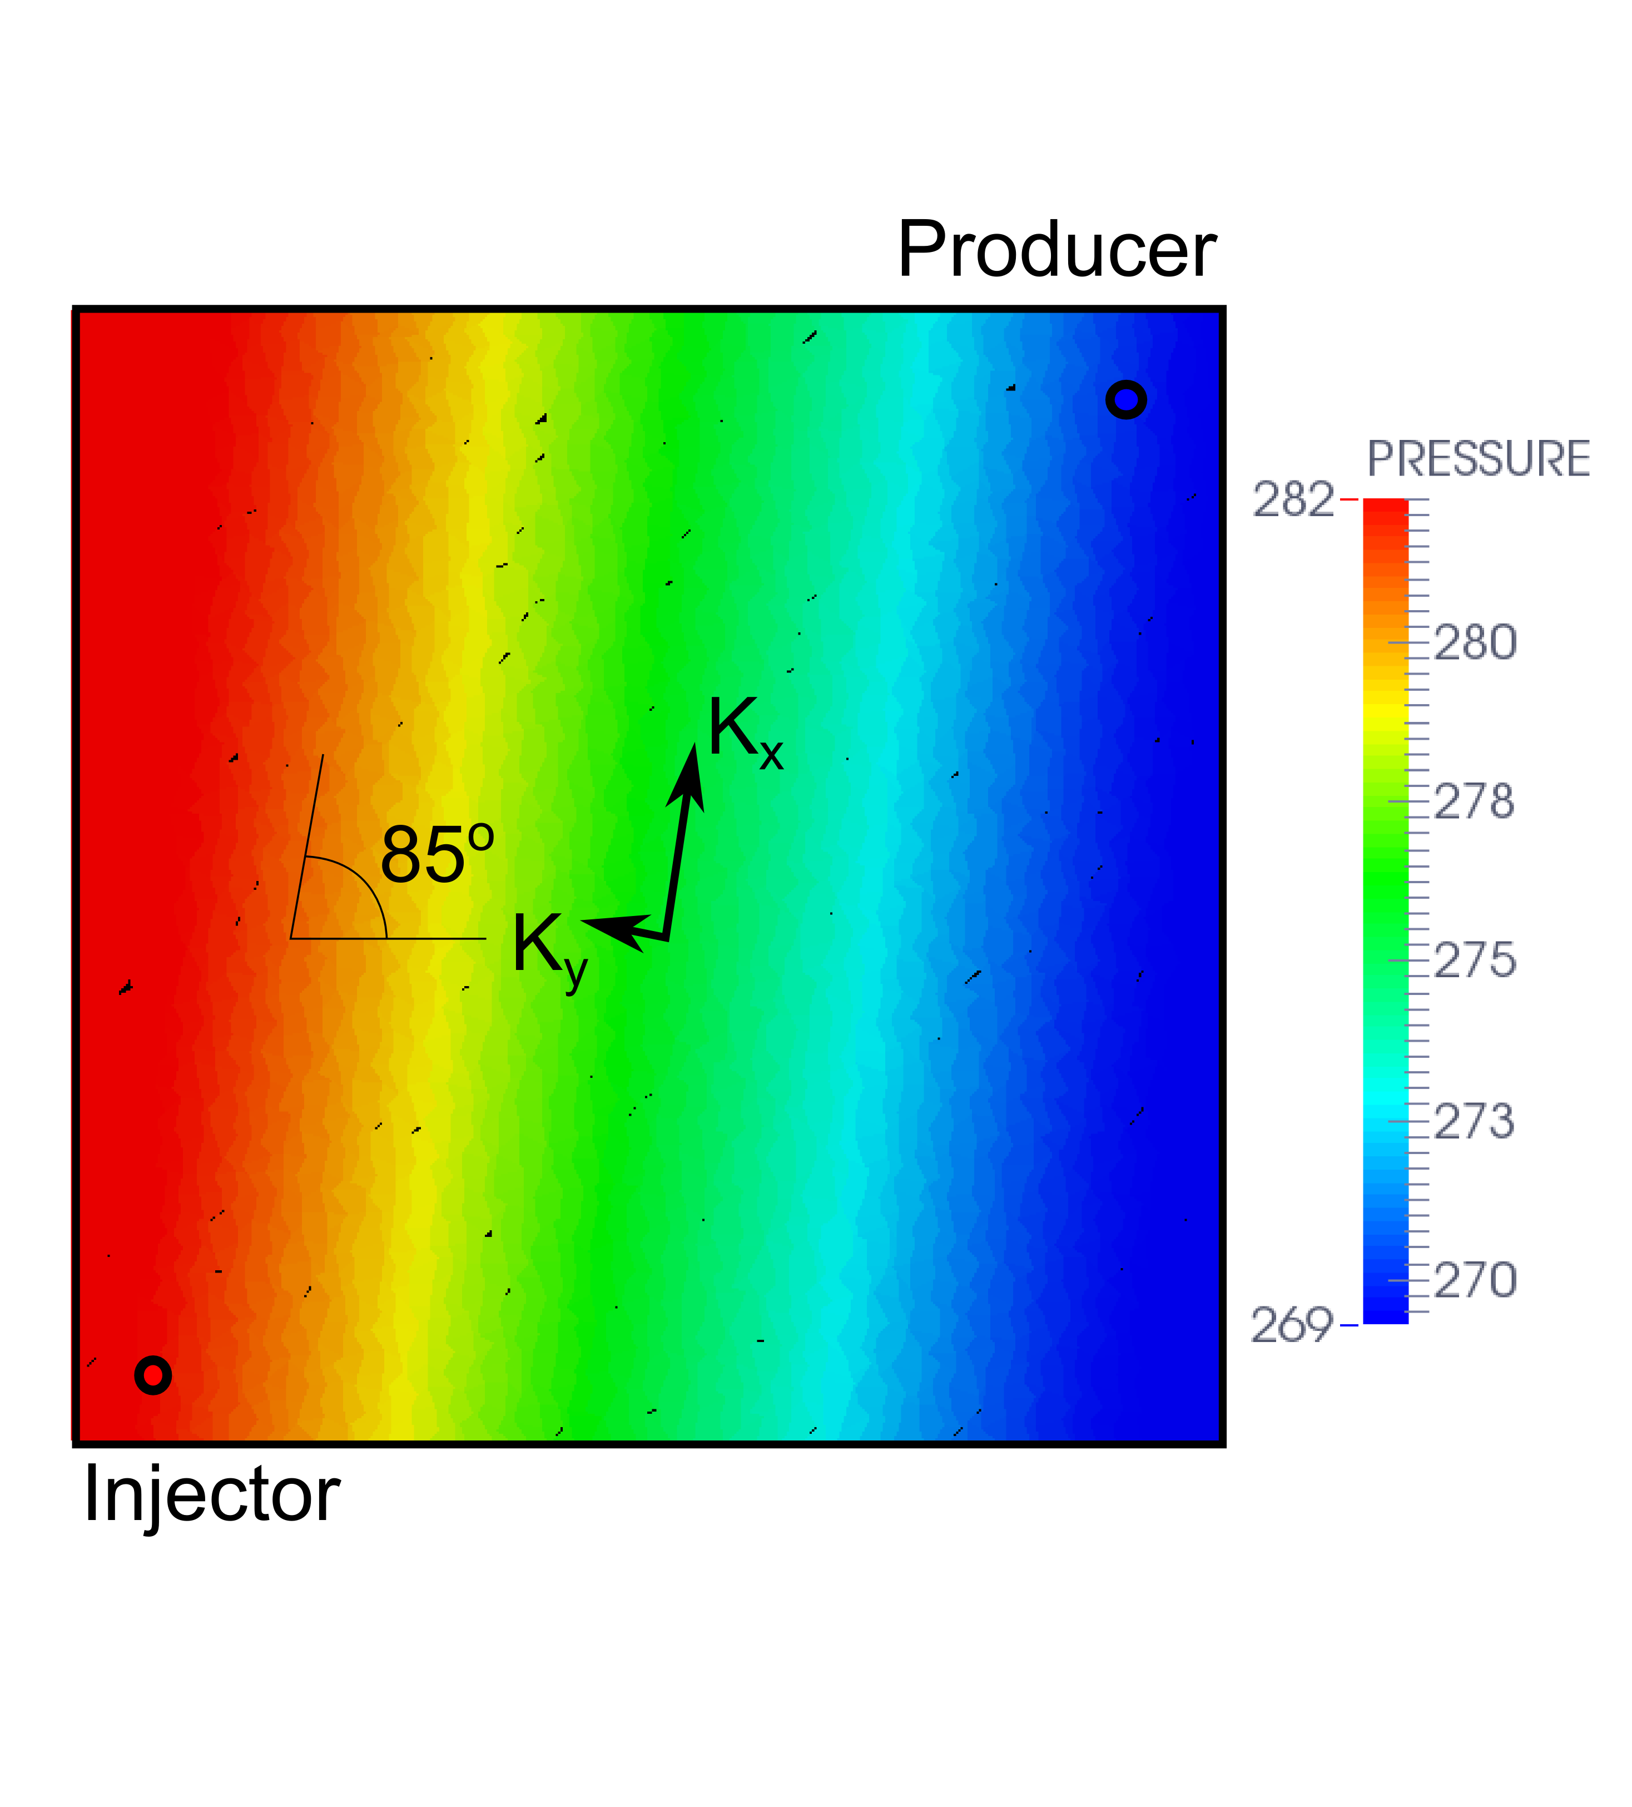
Simple single phase diffusion problem
MPFA-O, skewed Cartesian grid,
unstable
Nonlinear scheme, skewed Cartesian grid,
accurate
Notes:
Such an alternative is the nonlinear scheme. The accurate smooth result with nonlinear scheme is to the right, the previous unstable result with MPFA-O scheme is to the left. To achieve this we introduced dependence on the solution to the flux estimation and although the problem in question is linear the resulting approach is nonlinear. Why would we do this?

Slide 23
Transition to nonlinearity
No linear small stencil conservative scheme can be exact on linear solutions and respect the maximum principle.
[Kershaw 1981, Nordbotton 2005]
Notes:
Researchers noticed early that there is a problem with the combination of desired properties of the scheme. To achieve the discrete maximum principle, we have to either relax on small stencil (as far as I know this results in complete dependence, i.e. dense linear systems), conservativity which is highly undesirable, or accuracy, which is used with two-point flux approximation method.

Slide 24
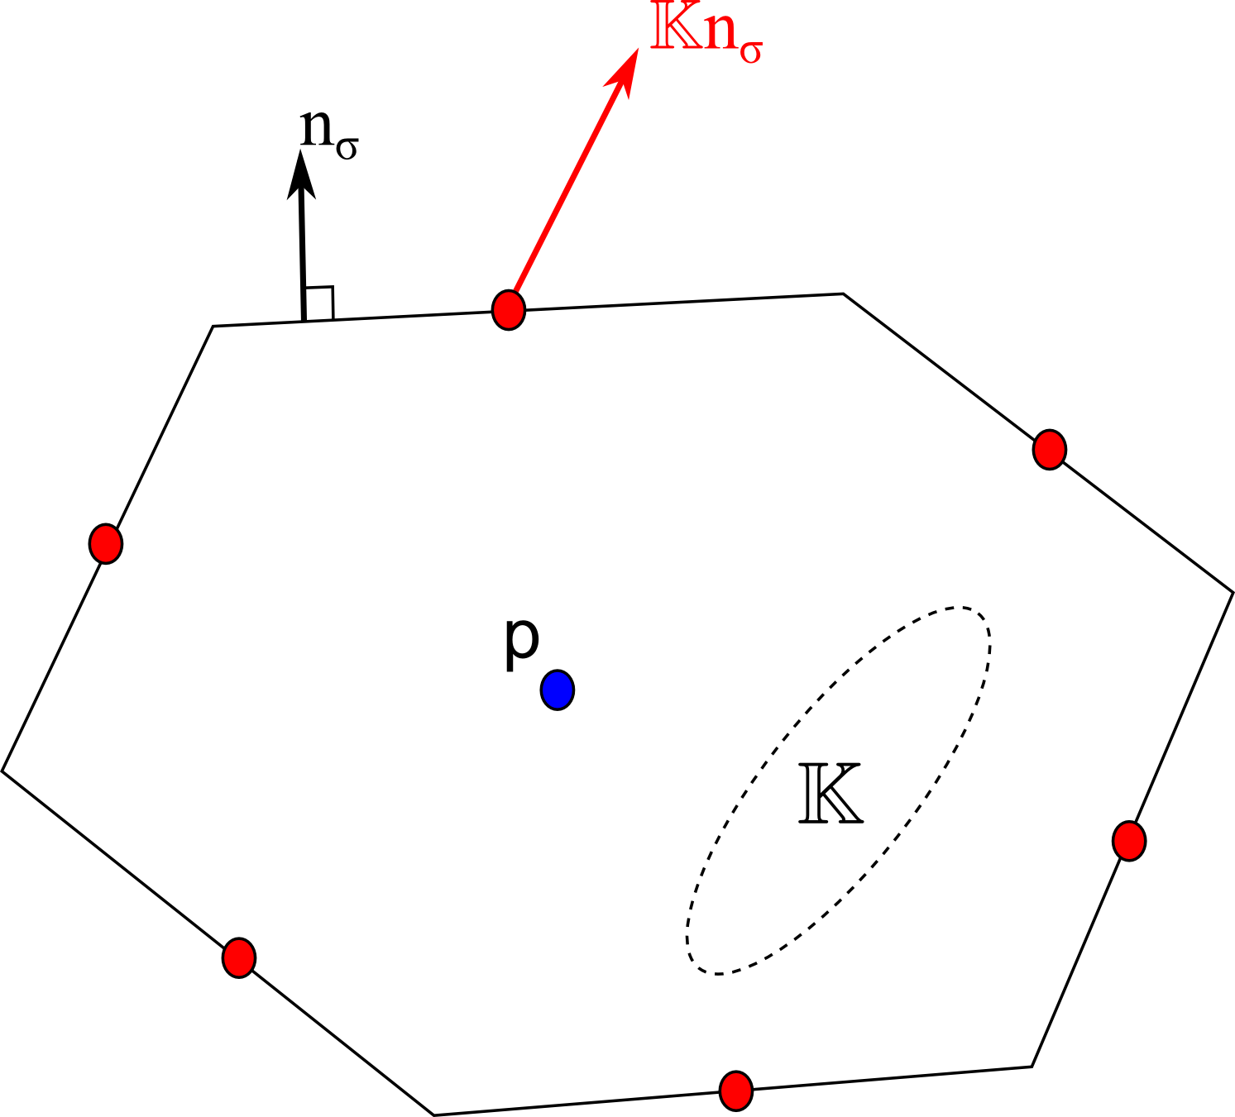
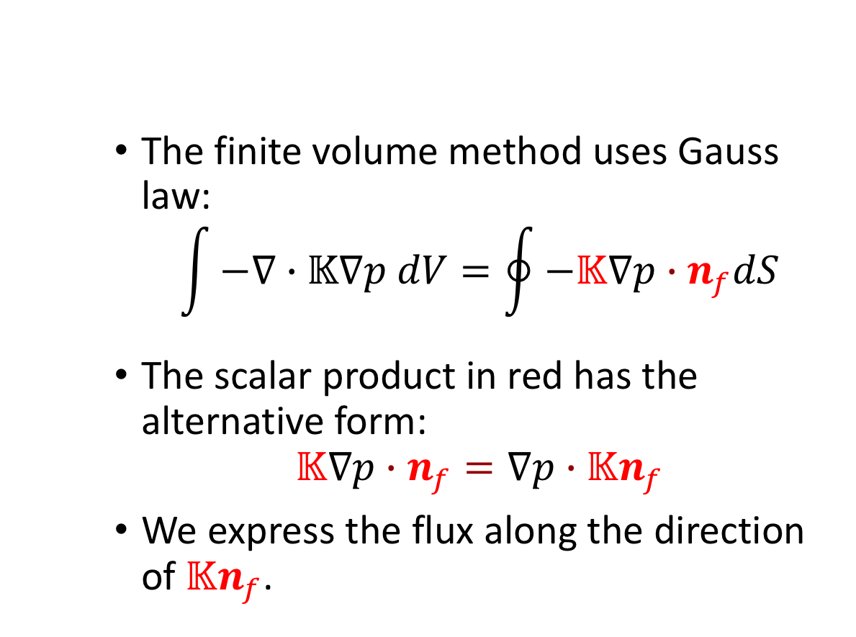
Diffusion Problem
The finite volume method uses Gauss law:
$$\int{−∇∙𝕂∇p dV=\oint{−𝕂∇p∙n_{f}dS}}$$
The scalar product in red has the alternative form:
$$𝕂∇p∙n_{f}=∇p∙𝕂n_{f}$$
We express the flux along the direction of $𝕂n_{f}$.
Notes:
Let us remind the construction of finite volume method in the case of anisotropic diffusion. (on picture) The pressure is considered to be defined at the centers of the cell, represented by blue dot and for finite volume method we have to determine the flux at the centers of the faces, represented by red dots. (first equation) The equation is considered in integral form and the intergral over volume of the cell is transformed into surface integral over faces of the cell. (second equation) The key ingredient in the method construction is the fact that in scalar product we can flip the tensor position from the gradient to the normal and after that manipulation in order to obtain the flux we have to determine the gradient of pressure along co-normal vector.

Slide 25
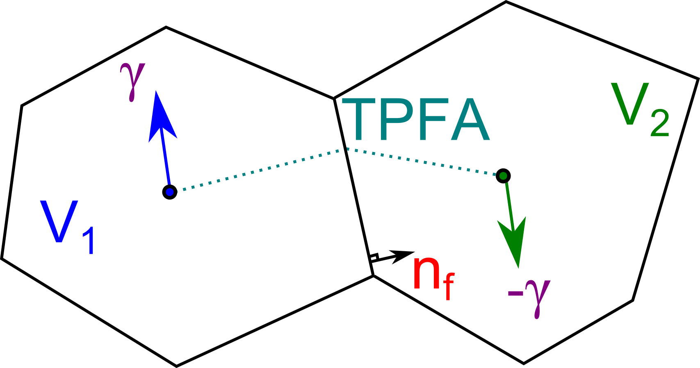
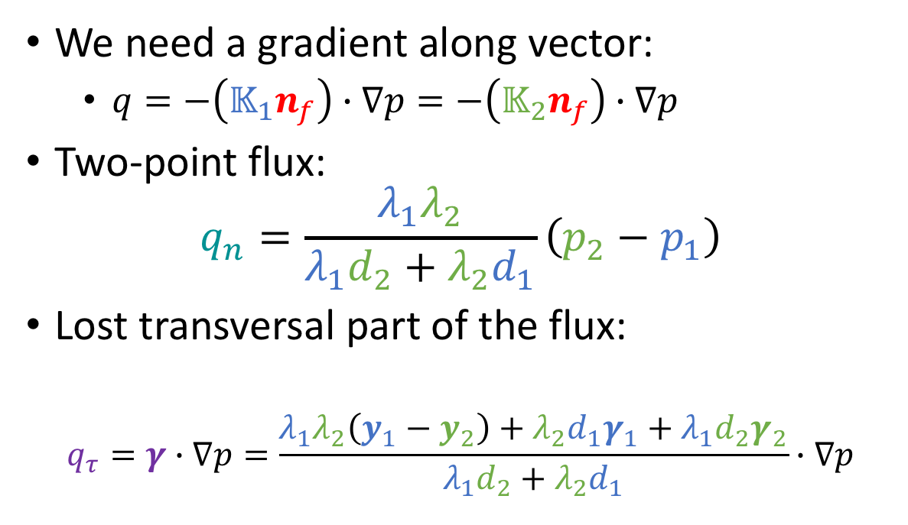
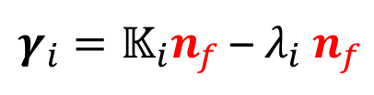
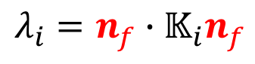
Diffusion Problem
We need a gradient along vector:
$q=−\left(𝕂_{1}n_{f}\right)∙∇p=−\left(𝕂_{2}n_{f}\right)∙∇p$
Two-point flux:
$$q_{n}=\frac{λ_{1}λ_{2}}{λ_{1}d_{2}+λ_{2}d_{1}}\left(p_{2}−p_{1}\right)$$
Lost transversal part of the flux:
$$q_{τ}=γ∙∇p=\frac{λ_{1}λ_{2}\left(y_{1}−y_{2}\right)+λ_{2}d_{1}γ_{1}+λ_{1}d_{2}γ_{2}}{λ_{1}d_{2}+λ_{2}d_{1}}∙∇p$$
$$λ_{i}=n_{f}∙𝕂_{i}n_{f}$$
$γ_{i}=𝕂_{i}n_{f}$ – $λ_{i} n_{f}$
Terekhov, Mallison, Tchelepi “Cell-Centered Nonlinear Finite-Volume Methods for the Heterogeneous Anisotropic Diffusion Problem”, JCP 2017
Notes:
In order to determine the flux over the interface in heterogeneous media we consider the continuity of the fluxes and the pressure; and decomposition of co-normals into orthogonal part (lambda) and transversal part (gamma). All the quantities are colored with blue and red for left and right cells, respectively. The continuity first yields us the two-point flux approximation method and second it results in vector gamma, common for both cells, that enters into scalar product of the missing transversal part in approximation of two-point flux approximation method. So the account of this part is important to recover the consistency of the two point flux approximation method, but it is hard to approximate it without violating stability. How do we achieve this?

Slide 26
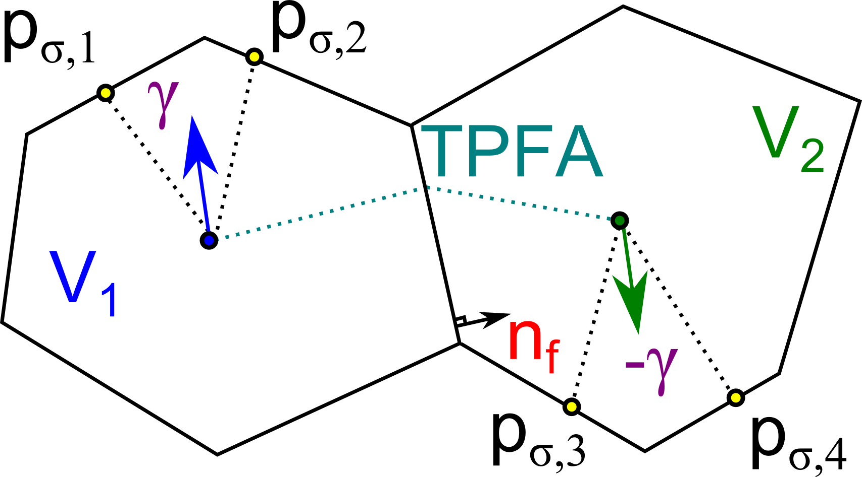
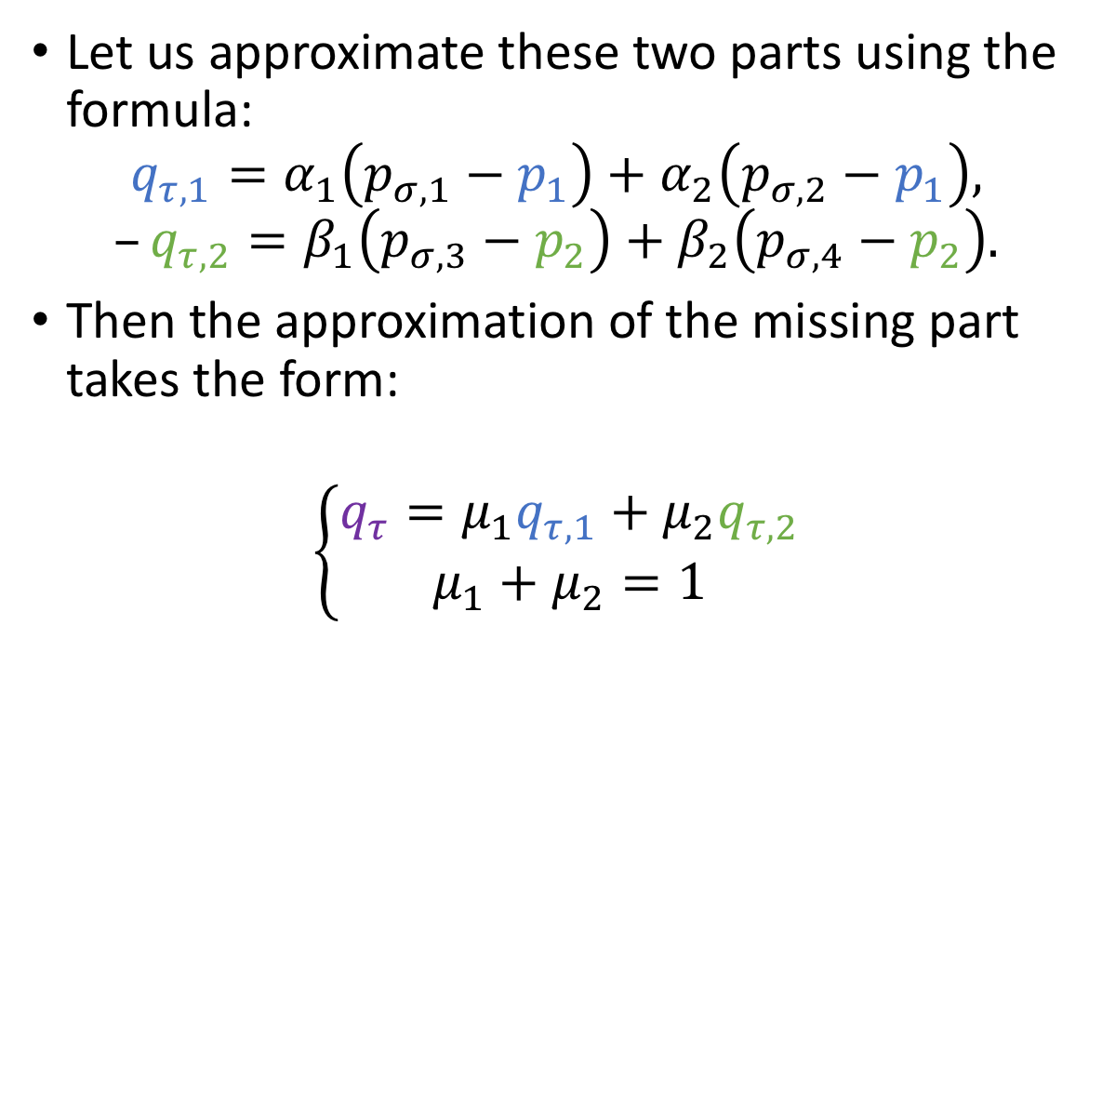
Diffusion Problem
Let us approximate these two parts using the formula:
$$q_{τ,1}=α_{1}\left(p_{σ,1}−p_{1}\right)+α_{2}\left(p_{σ,2}−p_{1}\right),$$
$$–q_{τ,2}=β_{1}\left(p_{σ,3}−p_{2}\right)+β_{2}\left(p_{σ,4}−p_{2}\right).$$
Then the approximation of the missing part takes the form:
$$\left\{\begin{matrix}q_{τ}=μ_{1}q_{τ,1}+μ_{2}q_{τ,2} \\ μ_{1}+μ_{2}=1\end{matrix}\right.$$
Notes:
Let us have some degrees of freedom or boundary conditions (pressures with sigma indices) that allow us to approximate the gradient of pressure along gamma vectors in each of the cells so that coefficients of alphas and betas is nonnegative. This results in two approximations of the flux in each of the cells. Then the final approximation for transversal part of the flux is given by convex combination of these two approximations. The key to stability of the method is the definition of mu.

Slide 27
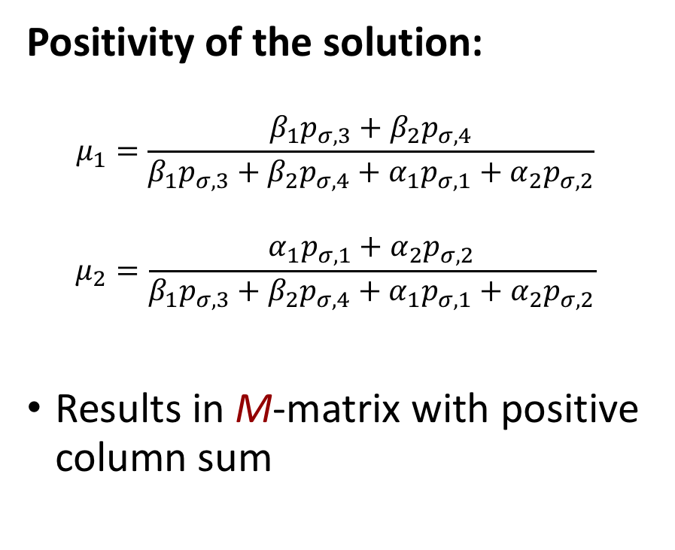
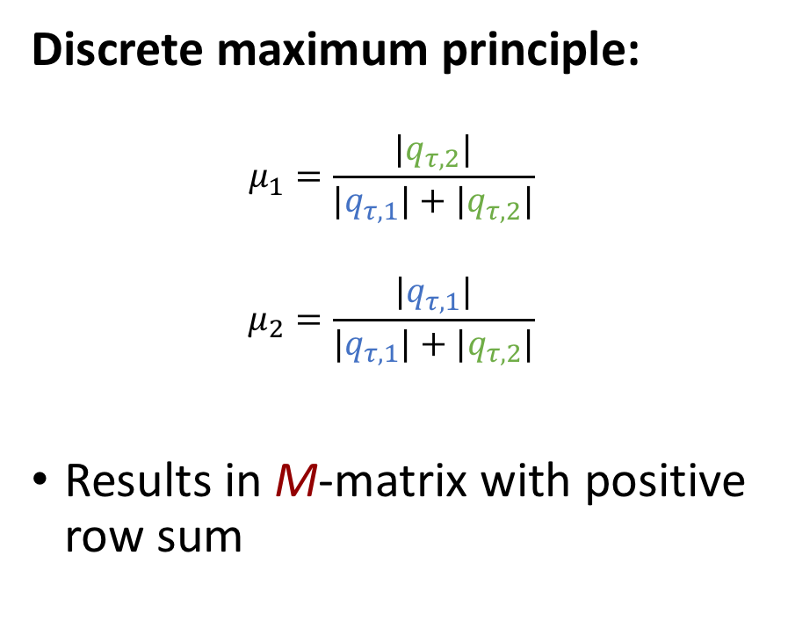
Nonlinear convex combination
Positivity of the solution:
$$μ_{1}=\frac{β_{1}p_{σ,3}+β_{2}p_{σ,4}}{{β_{1}p_{σ,3}+β}_{2}p_{σ,4}+α_{1}p_{σ,1}+α_{2}p_{σ,2}}$$
$$μ_{2}=\frac{α_{1}p_{σ,1}+α_{2}p_{σ,2}}{{β_{1}p_{σ,3}+β}_{2}p_{σ,4}+α_{1}p_{σ,1}+α_{2}p_{σ,2}}$$
Results in M-matrix with positive column sum
Discrete maximum principle:
$$μ_{1}=\frac{|q_{τ,2}|}{|q_{τ,1}|+{|q}_{τ,2}|}$$
$$μ_{2}=\frac{|q_{τ,1}|}{|q_{τ,1}|+{|q}_{τ,2}|}$$
Results in M-matrix with positive row sum
Varga, “Iterative Matrix Analysis”, 1962
Stoyan, “On maximum principles for monotone matrices”, 1986
Notes:
There are two possible choices of weights that result in desired properties for the scheme. From one side we can assemble nonlinear two-point scheme and obtain the positivity property since with Picard iterative method we obtain a monotone matrix that according to Varga (link in the bottom) is always positive. On the other side we can use van Albada limited averages to obtain a nonlinear multipoint scheme that produces an M-matrix and again according to Varga a highly desirable discrete maximum principle.

Slide 28
Overview
 | TPFA | MPFA | NTPFA | NMPFA
Exact on Linear Solutions | NO! | YES | YES | YES
Small Stencil | YES | YES | YES | YES
Linear | YES | YES | NO | NO
Respect Maximum Principle | YES | NO | NO | YES
Efficiency | YES | YES | YES | NO
MPFA
NTPFA
NMPFA
TPFA
?
Notes:
The TPFA scheme has a number of good properties, but the loss of approximation on non-K-orthogonal grids is very disturbing especially due to ubiquity of unstructured grids. It is impossible to construct K-orthogonal grids in any situation, which requires development of schemes working on general meshes. Although the discrete maximum principle is highly desirable, the derivative of the flux is not Lipschitz-continuous, the fact that deteriorates convergence rate of Newton method down to none. In previous works we demonstrated various techniques to improve on the problem, the usage of the good scheme is still a big compromise for efficiency. The search may happen in two directions – to construct Lipschitz-continuous flux (we did it and run into inflection point problems) and to consider nonlinear multigrid methods.

Slide 29
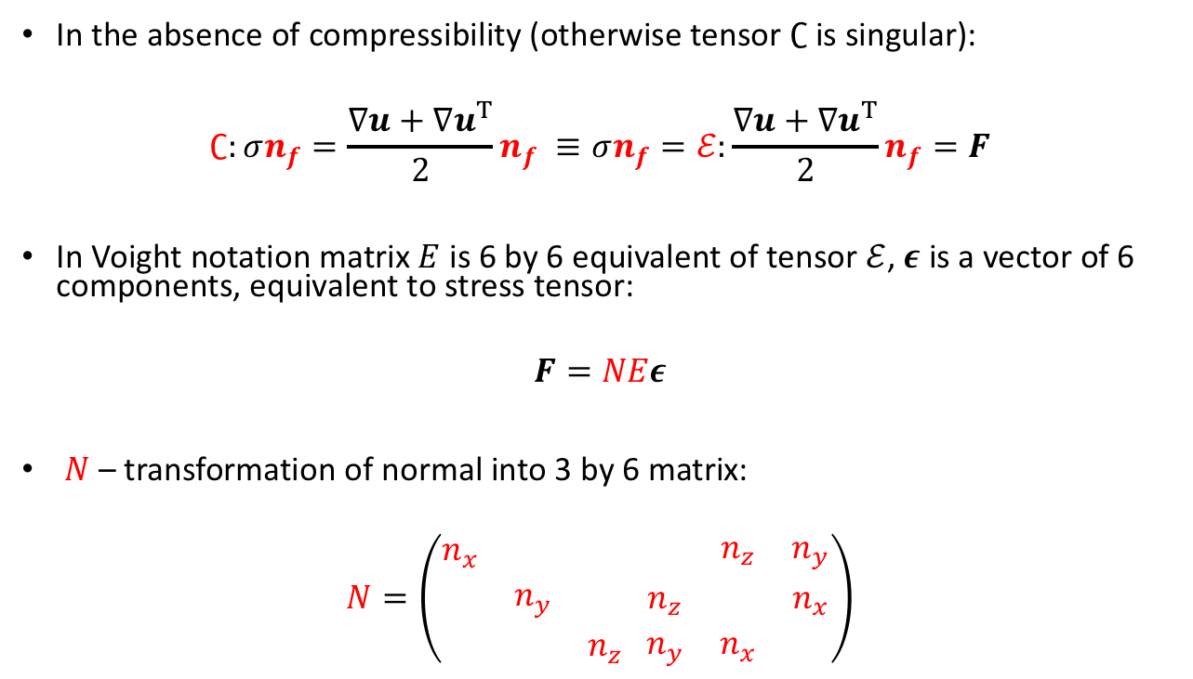
Linear Elasticity Problem
In the absence of compressibility (otherwise tensor $∁$ is singular):
$$∁:σn_{f}=\frac{∇u+{∇u}^{T}}{2}n_{f} ≡σn_{f}=ℰ:\frac{∇u+{∇u}^{T}}{2}n_{f}=F$$
In Voight notation matrix $E$ is 6 by 6 equivalent of tensor $ℰ$, $ε$ is a vector of 6 components, equivalent to stress tensor:
$$F=NEε$$
$N$ – transformation of normal into 3 by 6 matrix:
$$N=\left(\begin{matrix}n_{x} & & \\ & n_{y} & \\ & & n_{z}\end{matrix} \begin{matrix} & n_{z} & n_{y} \\ n_{z} & & n_{x} \\ n_{y} & n_{x} & \end{matrix}\right)$$
Notes:
Let us first note that at present we do not consider incompressible and rigid-tropic materials (in this case C is singular matrix and cannot be inverted, in case someone asks we can consider such materials by introducing structural pressure but this is another level of complexity). As in the case of the diffusion problem the main question for the finite volume method is how to define the flux on the interface (blue square) given that we have cell-centered displacements (red circle). (first equation) In order to obtain the flux expression we first invert the tensor. One may see that in case of linear elasticity equation it is not as easy to split the gradient of displacement and co-normal tensor, since we have a symmetric gradient and from the first sight it is unclear how do we put together the tensor with the normal as we did with anisotropic diffusion. (second equation) The next step is to transform the expression for the flux F to the Voight notation. and in Voight notation the matrix N, corresponding to normal and symmetric matrix E, corresponding to tensor indeed appear together. The epsilon vector is the vector corresponding to strain tensor in Voight notation. (third equation) The N matrix has this form, the expression is not something that is easy to find in a book on mechanics.

Slide 30
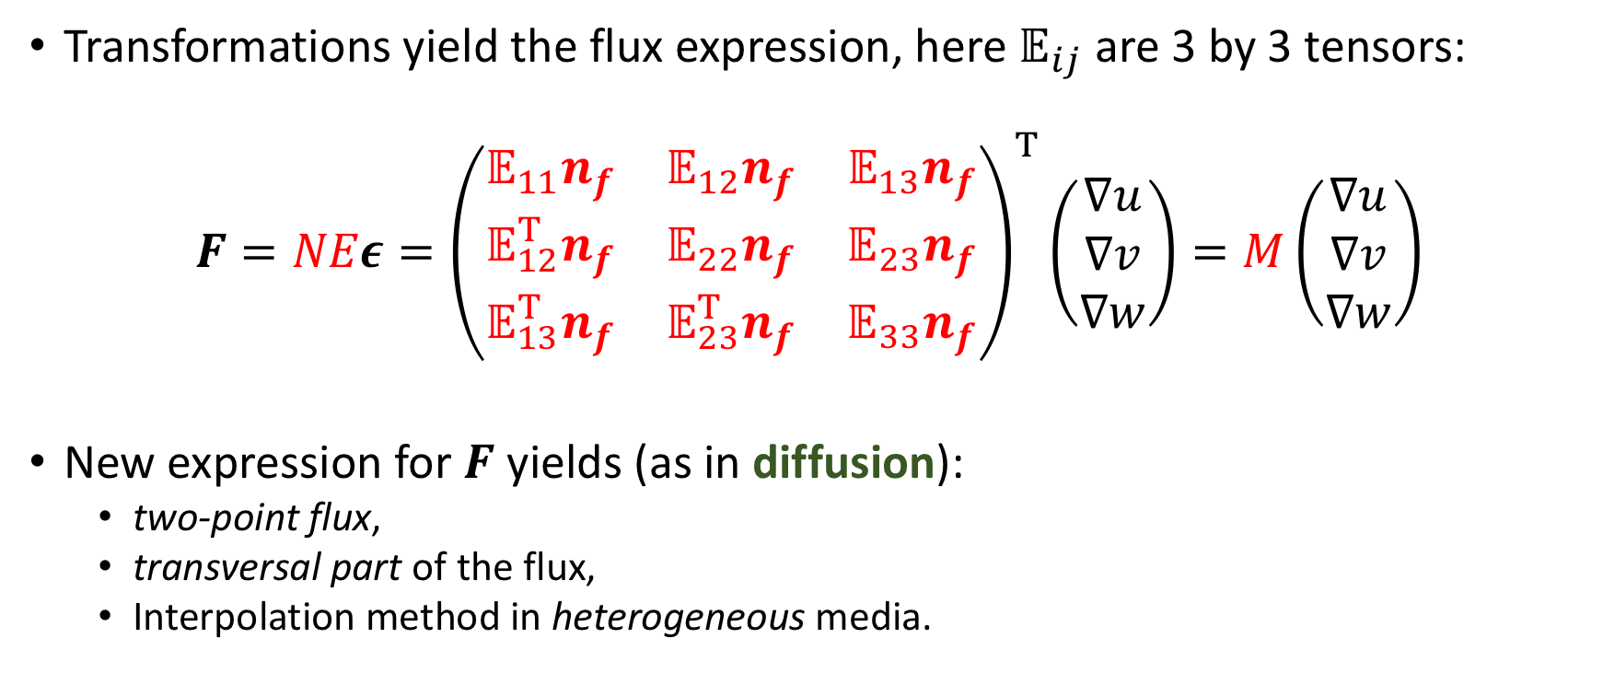
Linear Elasticity Problem
Transformations yield the flux expression, here $𝔼_{ij}$ are 3 by 3 tensors:
$$F=NEε={\left(\begin{matrix}𝔼_{11}n_{f} & 𝔼_{12}n_{f} & 𝔼_{13}n_{f} \\ 𝔼_{12}^{T}n_{f} & 𝔼_{22}n_{f} & 𝔼_{23}n_{f} \\ 𝔼_{13}^{T}n_{f} & 𝔼_{23}^{T}n_{f} & 𝔼_{33}n_{f}\end{matrix}\right)}^{T}\left(\begin{matrix}∇u \\ ∇v \\ ∇w\end{matrix}\right)=M\left(\begin{matrix}∇u \\ ∇v \\ ∇w\end{matrix}\right)$$
New expression for $F$ yields (as in diffusion):
two-point flux,
transversal part of the flux,
Interpolation method in heterogeneous media.
Notes:
Analysis of expression provided by the Voight notation allows us to obtain 9 co-normal vectors, similar to those that we have seen in diffusion. Let us call the 3 by 9 M matrix here as the co-normal tensor. In the following we will introduce the two-point flux expression, the transversal correction to the flux. The form also allows one to introduce MPFA-O scheme for elasticity without utilizing weak symmetry as Jan Martin Nordbotten did.

Slide 31
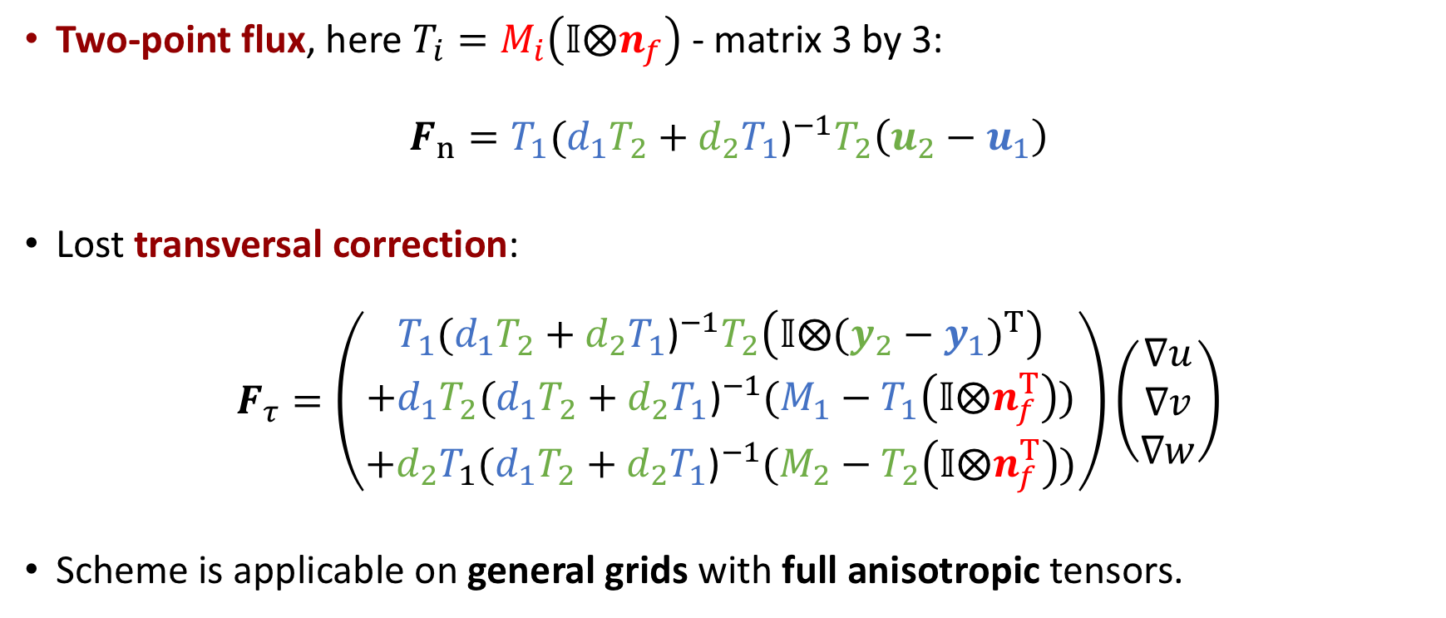
Linear Elasticity Problem
Two-point flux, here $T_{i}=M_{i}\left(𝕀⨂n_{f}\right)$ - matrix 3 by 3:
$$F_{n}=T_{1}{(d_{1}T_{2}+d_{2}T_{1}\text{)}}^{−1}T_{2}\left(u_{2}−u_{1}\right)$$
Lost transversal correction:
$$F_{τ}=\left(\begin{aligned}T_{1}{(d_{1}T_{2}+d_{2}T_{1}\text{)}}^{−1}T_{2}\left(𝕀⨂{(y_{2}−y_{1})}^{T}\right) \\ +d_{1}T_{2}{(d_{1}T_{2}+d_{2}T_{1}\text{)}}^{−1}(M_{1}−T_{1}\left(𝕀⨂n_{f}^{T}\right)) \\ +{d_{2}T}_{1}{(d_{1}T_{2}+d_{2}T_{1}\text{)}}^{−1}(M_{2}−T_{2}\left(𝕀⨂n_{f}^{T}\right))\end{aligned}\right)\left(\begin{matrix}∇u \\ ∇v \\ ∇w\end{matrix}\right)$$
Scheme is applicable on general grids with full anisotropic tensors.
Tensorial harmonic average
Terekhov, Tchelepi “Cell-centered finite volume method for heterogeneous full-tensor anisotropic linear elasticity”, submitted to CMAME
Notes:
Following the design pattern of the anisotropic diffusion scheme we can derive the two point flux approximation scheme for elasticity problem (first equation) and the missing transversal part of the flux (second equation). Note that here T is the projection of tensorial co-normal onto normal which corresponds to lambda in the case of anisotropic diffusion equation and as we’ve got the harmonic average for lambda’s in the same fashion we get tensorial harmonic averaging for T’s. We haven’t yet tried to create a nonlinear scheme because it is not yet completely clear what property do we want to satisfy by nonlinear method. But the results that would follow suggest certain path.

Slide 32

Incompressible Navier-Stokes
Flux expression:
$$F=\left\{\begin{aligned}ρuu^{T}n_{f}−μ∇un_{f}+pn_{f} \\ n_{f}^{T}u\end{aligned}\right.$$
Key part for stabilization is the analysis of the system:
$F_{GD}=\left\{\begin{aligned}pn_{f} \\ n_{f}^{T}u\end{aligned}\right.=\left(\begin{matrix} & n_{f} \\ n_{f}^{T} & \end{matrix}\right)\left[\begin{matrix}u \\ p\end{matrix}\right]=\frac{1}{2}\left(\begin{matrix}n_{f}n_{f}^{T} & n_{f} \\ n_{f}^{T} & 1\end{matrix}\right)\left[\begin{matrix}u \\ p\end{matrix}\right]$+ $\frac{1}{2}$ $\left(\begin{matrix}−n_{f}n_{f}^{T} & n_{f} \\ n_{f}^{T} & −1\end{matrix}\right)\left[\begin{matrix}u \\ p\end{matrix}\right]$
Accurate (nonlinear) approach to approximation removes oscillations.
Positive and negative
eigenvalues
Positive eigenvalue
Negative eigenvalue
Terekhov, Vassilevski, “On A Finite-Volume Method For Saddle-Point Problems”, Submitted to JCP
Terekhov, Vassilevski “Stable collocated finite-volume method for incompressible Navier-Stokes equations”, In preparation
Notes:
Let us consider the definition of the flux. Let us extract the part of the gradient of pressure and the divergence of velocity. As we have noticed previously in poromechanics problem, this part of the flux has a matrix multiplier with exactly one negative eigenvalue and one positive eigenvalue. With eigen-decomposition we can split this matrix into two matrices with positive eigenvalue and negative eigenvalue. An accurate approximation (recall the advection problem) of the velocity and pressure leads to a block-structured matrix with positive-definite block on the diagonal and negative-definite blocks off-diagonal. From the numerous tests we see that the physical solution is recovered with the new approach. Although there is no such theory for matrices of this structure in the literature, as there is in Varga’s book for M-matrices, this block-M-matrix structure is something that we should look for when constructing nonlinear methods for elasticity and poromechanics.

Slide 33


Incompressible Navier-Stokes
Poiseuille flow:
Demonstrates second-order convergence on Ethier-Steinman problem, error norms are comparable to projection scheme on staggered grid (MAC-scheme).
Positive-definite div-grad
Direct approximation of div-grad
Notes:
Let us demonstrate the recovery of the physical pressure with a simple problem of Poiseuille flow in a pipe. As we can see to the right the unphysical checkerboard pattern in the flow direction is present with naïve approximation method. The picture to the left demonstrates that the pressure is smooth with the new method. On analytical problems the method demonstrates the second order of accuracy.

Slide 34

Thank you for Attention!
www.inmost.org
Kirill.terehov@gmail.com
Yuri.vassilevski@gmail.com

